Slide 1
Deep Neural Network (DNN) Method to predict the displacement behavior of neutral axis for ships in vertical bending
NAV 2022
20th International Conference on Ship and Maritime Research
Genova – La Spezia, 15-17 June 2022
Genova, Italy
June 15, 2022
Alessandro La Ferlita ABS Europe ltd Germany | Emanuel Di Nardo University of Naples Parthenope, University of Milan | Massimo Macera
Thomas Lindemann University of Rostock Germany | Patrick Kaeding University of Rostock Germany | Angelo Ciaramella University of Naples Parthenope

Slide 2
Overview
Introduction
Motivation
DNN Method
Results: Leave-one-out technique
Results: Wild Data
Conclusions

Slide 3
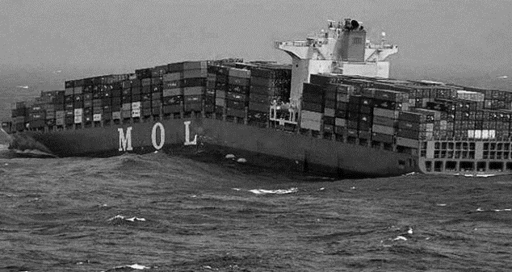
Introduction
Several methodologies for computation of ultimate hull girder strength exist:
Presumed stress distribution-based method
Finite Element Method (FEM)
Idealized Structural Unit Method (ISUM)
Intelligent Supersize Finite Element Method (ISFEM)
Some further methods could be employed?
DNN (Deep Neural Network)

Slide 4
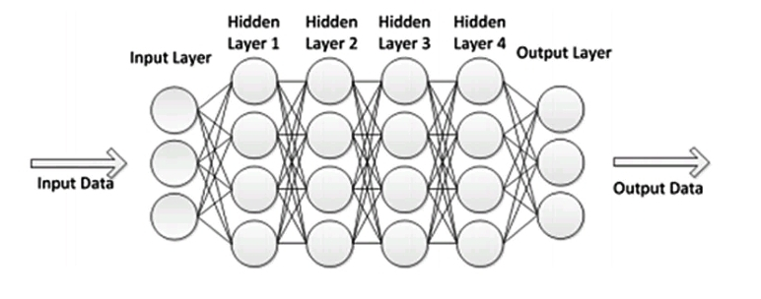
Introduction
DNN successfully applied in various marine engineering fields
Shorten the computation time for the result prediction
Typical High Accuracy Estimation
Reduced Modeling efforts
How to determine the ultimate hull girder strength?
Reference:
Kamaljit, I., and D. Modi. "Deep Learning: Architectures and Applications." In Handbook of Research on Deep Learning Innovations and Trends, by Aboul Ella Hassanien, Ashraf Darwish and Chiranji Lal Chowdhary, 133-136. 2019.

Slide 5
Overview
Introduction
Motivation
DNN Method
Results: Leave-one-out technique
Results: Wild Data
Conclusions

Slide 6
Motivation
Study can be counted as initial phase for successive prediction of residual ultimate strength
Understanding of the DNN results and of specific feature weights play a paramount role for further steps which consists into more relevant prediction of ultimate hull girder strength
Neutral Axis (3500 TEU Container Vessel)
Moment-Curvature Curve (Vertical Bending)

Slide 7
Overview
Introduction
Motivation
DNN Method
Results: Leave-one-out technique
Results: Wild Data
Conclusions

Slide 8
DNN Method
Five different Cross Sections have been considered
Vessel | Length [m] | Breadth [m] | Depth [m]
Double Hull Oil Tanker | 315 | 58 | 30.3
Single Hull Tanker | 313 | 48.2 | 25.2
1350TEU Container | 147 | 25 | 14.8
3500TEU Container | 230 | 32.2 | 21.5
Bulk Carrier | 285 | 50 | 26.7
Reference:
ISSC Committee VI.2: Ultimate Hull Girder Strength. Proceedings of the 14th International Ship and Offshore Structure Congress, Vol 2: pp. 321-391, Nagasaki, Japan, 2000.
Cross section discretization:
(a) Double Hull Oil Tanker, (b) Single Hull Tanker, (c) 3500TEU Container, (d) Bulk Carrier, (e) 1350TEU Container

Slide 9
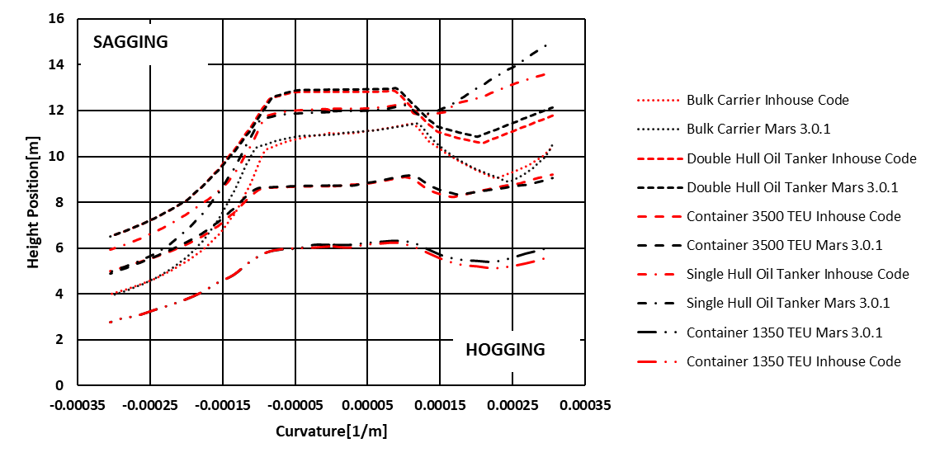
DNN Method
Initial source data have been generated by considering numerical residual strength calculations (obtained with a self developed code based on Smith Method), where the neutral axis at each iteration is established by imposing the force equilibrium over the whole midship section.

Slide 10
DNN Method
Damage Scenarios
Scenario | Damage Width Extension | Damage Height Extension (DB)
Intact | 0% | 0%
A | 20% | 0%
B | 40% | 40%
C | 60% | 60%
D | 80% | 80%
E | 90% | 90%
Simulated cases have been chosen by increasing progressively damage height and damage width with respect to the vessel center line
Only symmetrical damages have been considered
Scenario Intact
Scenario A
Scenario B
Scenario C
Scenario D
Scenario E
.

Slide 11
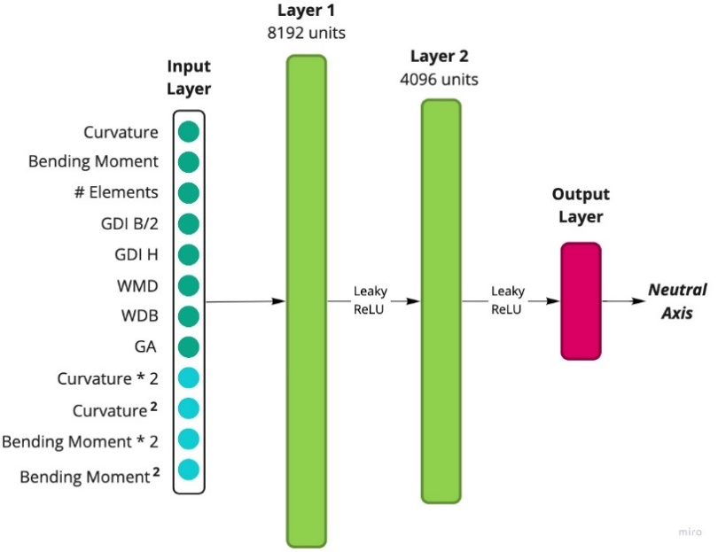
DNN Method
DNN Architecture
Due to limited number of data and features, the input layer is composed of not only the initial parameters (green bullets), but a slightly data augmentation is performed to extrapolate more information (light blue bullets)

Slide 12
Overview
Introduction
Motivation
DNN Method
Results: Leave-one-out technique
Results: Wild Data
Conclusions

Slide 13
Results: Leave-one-out
Neutral Axis Displacement Prediction
Leave-on-out approach to validate DNN
Double Hull Oil Tanker (Scenario Intact)
Double Hull Oil Tanker (Scenario D)

Slide 14
Results: Leave-one-out
Neutral Axis Displacement Prediction
Leave-on-out approach to validate DNN
Bulk Carrier (Scenario C)
Container 1350 TEU (Scenario C)

Slide 15
Overview
Introduction
Motivation
DNN Method
Results: Leave-one-out
Results: Wild Data
Conclusions

Slide 16
Results: Wild Data
Neutral Axis Displacement Prediction
Wild Data: New Scenarios unknow to the DNN
Scenarios for wild data
Bulk Carrier (Scenario F)
Scenario | Damage Width Extension | Damage Height Extension (DB)
F | 12% | 35%
G | 37% | 100%
H | 17% | 40%

Slide 17
Results: Wild Data
Neutral Axis Displacement Prediction
Wild Data: New Scenarios unknow to the DNN
Double Hull Oil Tanker (Scenario G)
Double Hull Oil Tanker (Scenario H)

Slide 18
Overview
Introduction
Motivation
DNN Method
Results: Leave-one-out
Results: Wild Data
Conclusions

Slide 19
Conclusions
Results obtained by predicting new scenarios unknown to DNN show good agreement with the actual corresponding values
Determination of neutral axis position and ultimate capacity strength could evoke application of simple model 2D tools
Presented approach ensures to successfully determine behavior of instantaneous neutral axis rapidly
Good agreement prediction for the neutral axis displacement behavior will consolidate development of ultimate hull girder strength computation by applying DNN with increased number of samples and reduced number of features
Initial source database could be improved and extended considering more precise calculation methods e.g., Finite Element Method (FEM), Idealized Structural Unit Method (ISUM)

Slide 20
Thank You for Your Attention!

