Slide 1
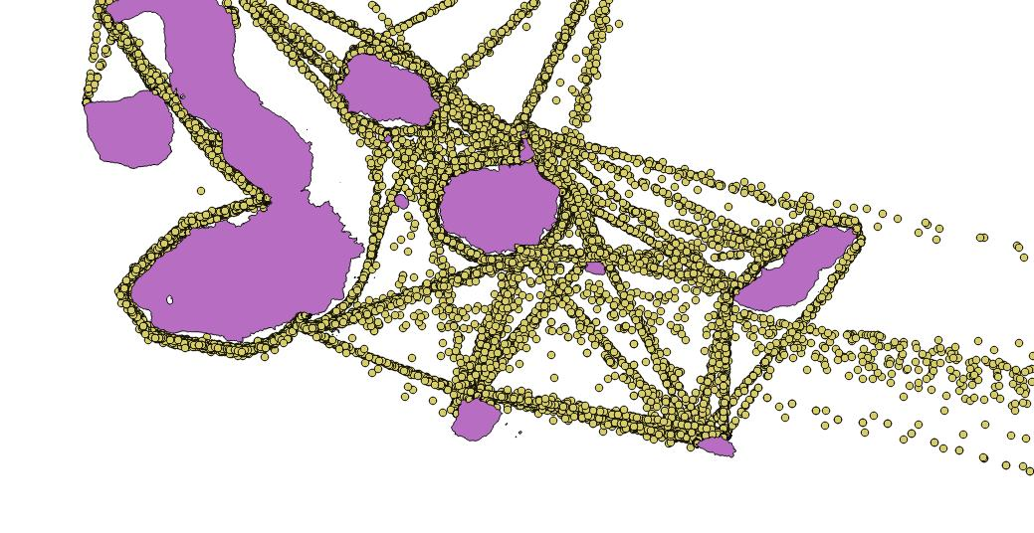
Optimal conceptual design using NSGA-II algorithm for Galapagos interisland service small craft including flaps
José R. Marín-Lopez, Janeth L. Meléndez, Rubén J. Paredes and
Esteban L. Castro-Feliciano
20th Internatinoal Conference on Ship and Maritime Research
Genova – La Spezia, 15 – 17 June 2022

Slide 2
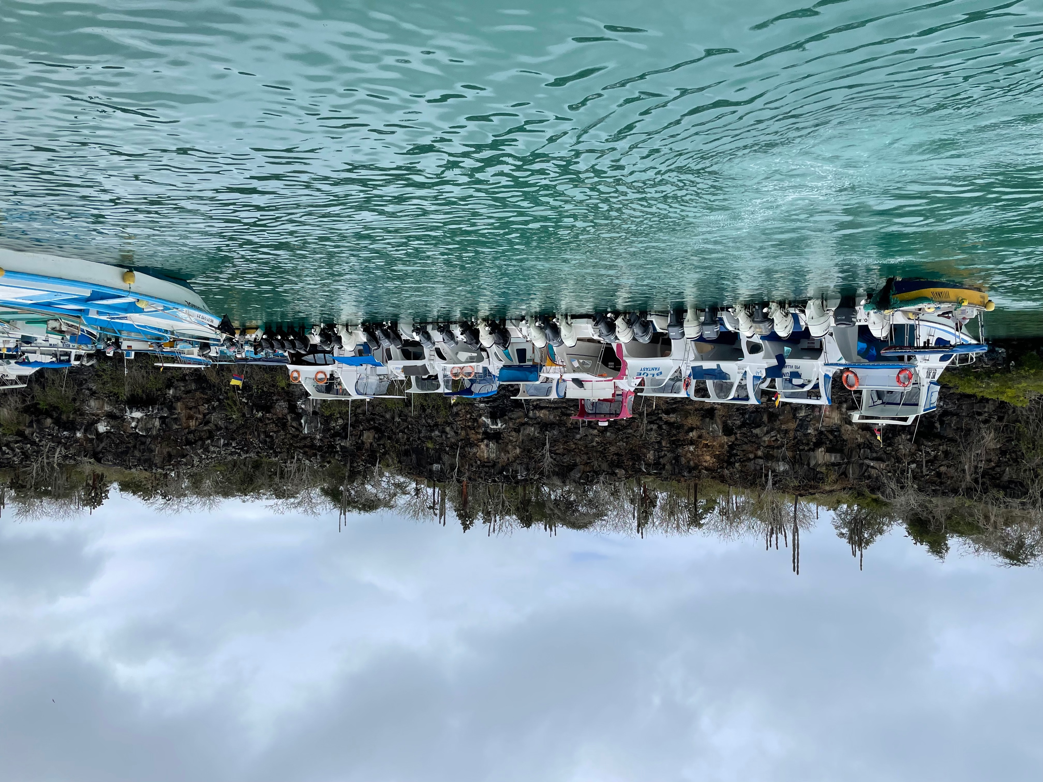
Agenda
ZEGal project
Sea trials performed
Flaps used for HSC
Optimization procedure
Results
Conclusions
Future work
Academy bay, Santa Cruz
20th Internatinoal Conference on Ship and Maritime Research
Genova – La Spezia, 15 – 17 June 2022

Slide 3
ZEGal project
Main objectives
Design a Zero emission small HSC.
Improve passenger comfort, and
Reduce the risk of collision with sea turtles.
Optimization at conceptual level
Experimental work and numerical simulations
Sea trials
Energy saving devices
Zero emission propulsion system
20th Internatinoal Conference on Ship and Maritime Research
Genova – La Spezia, 15 – 17 June 2022

Slide 4
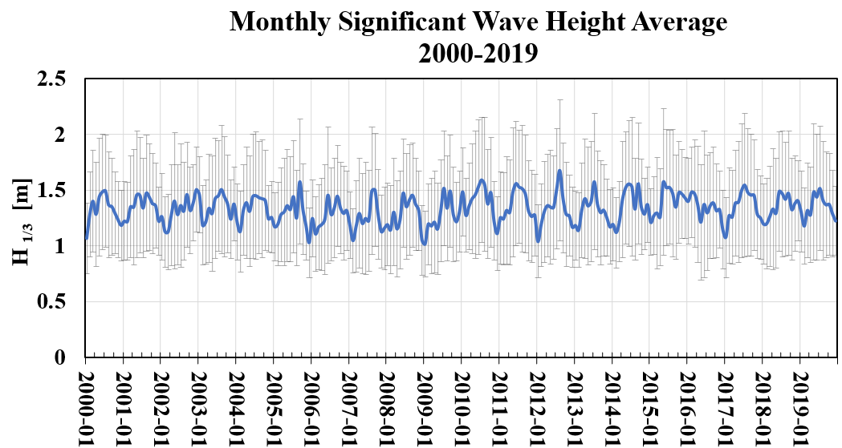
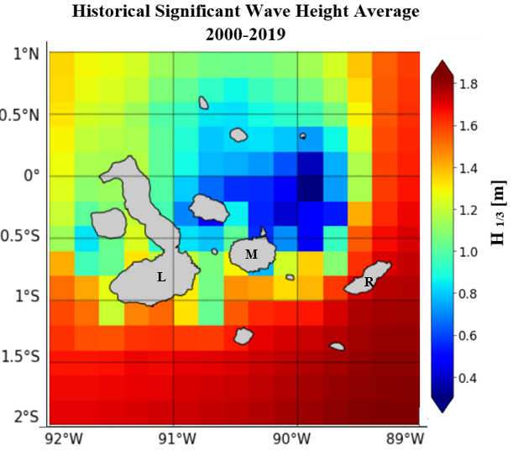
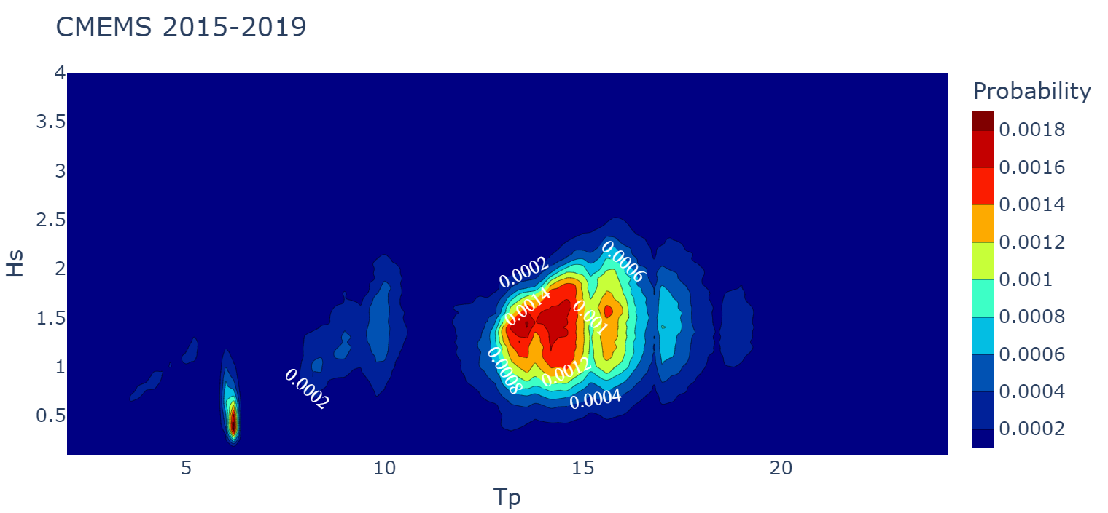
Sea trials performed
Sea state in Galapagos
Monthly variation of the averaged Significant Wave Height from 2000-2019 (blue line), and standard deviation (gray bars).
Average Significant Wave Height considering numerical forecast from 2000 to 2019 provided by CMEMS. The inhabited islands are Isabela (L), Santa Cruz (M), and San Cristobal (R).
20th Internatinoal Conference on Ship and Maritime Research
Genova – La Spezia, 15 – 17 June 2022

Slide 5
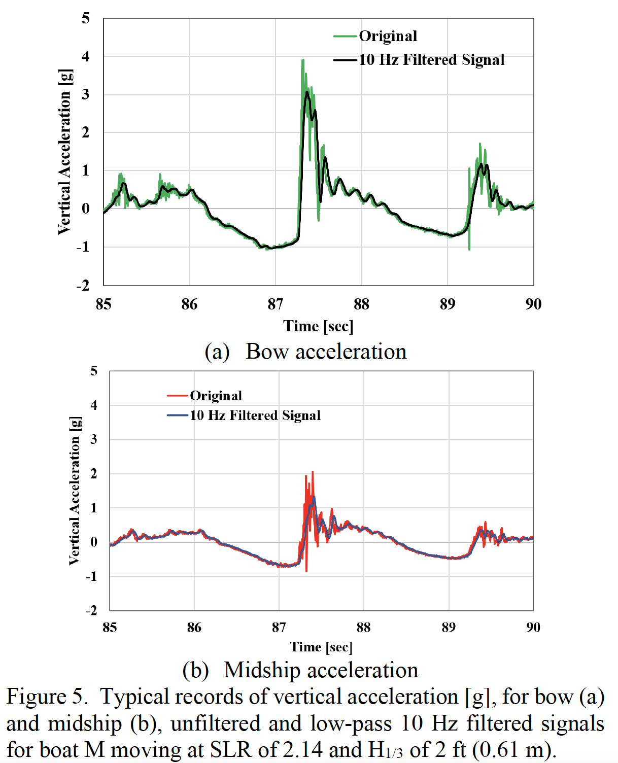
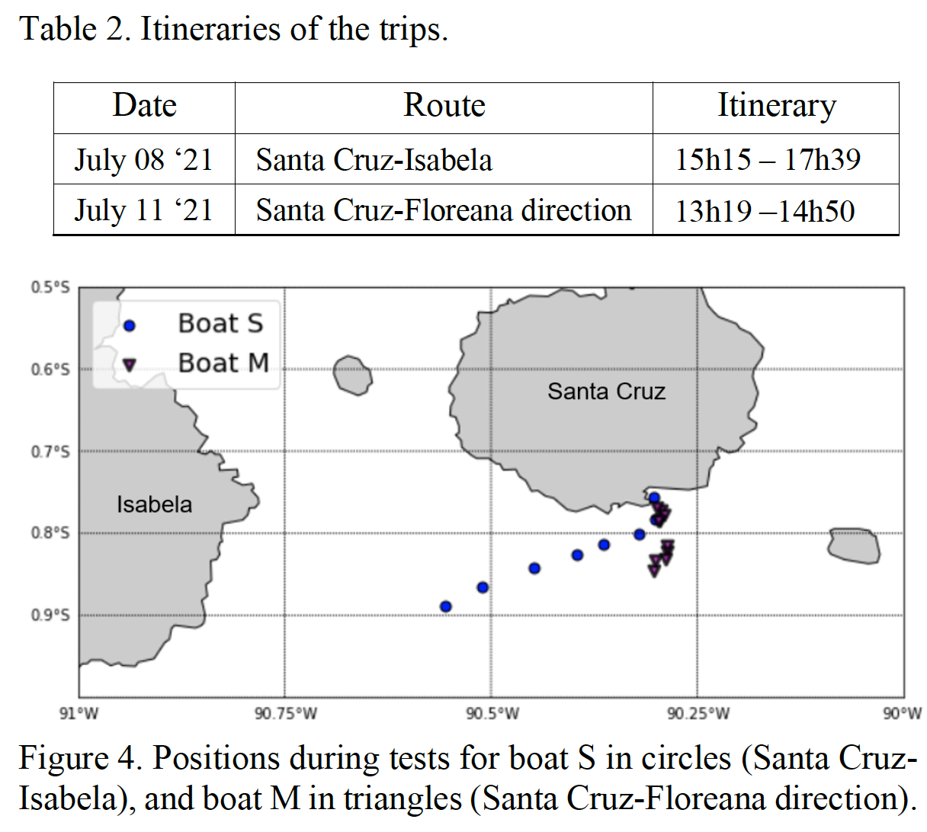
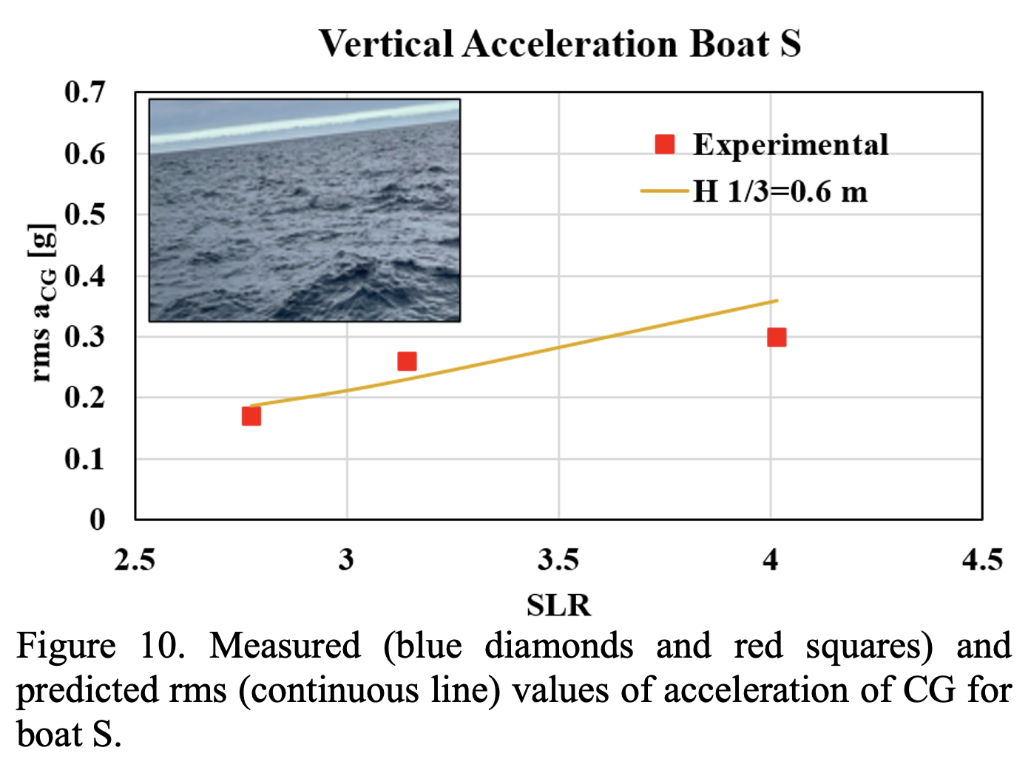
Sea trials performed
Influence on passengers
$$SLR= {V_{K}}/{\sqrt{LWL }}$$
Standar G method used to assess RMS A_{CG}
MSI of ~20%
20th Internatinoal Conference on Ship and Maritime Research
Genova – La Spezia, 15 – 17 June 2022

Slide 6
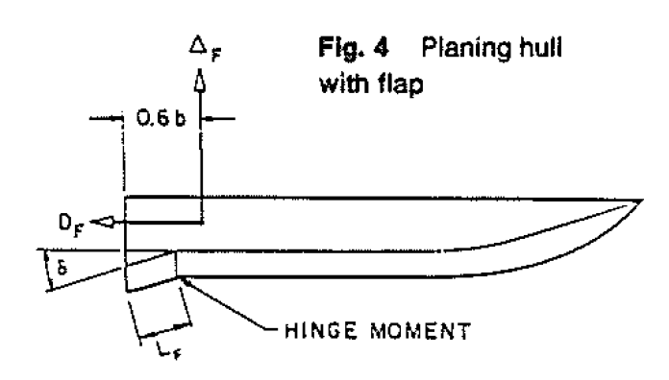
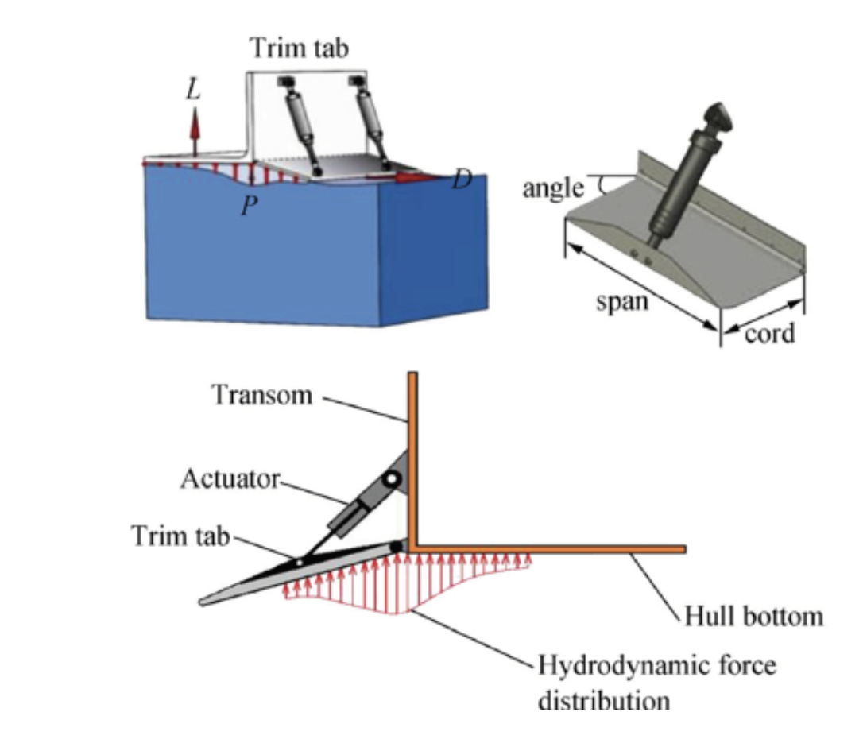
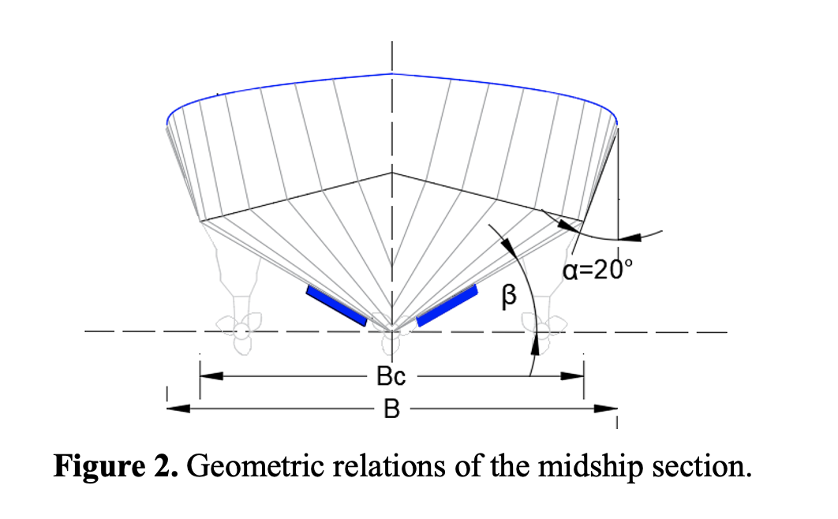
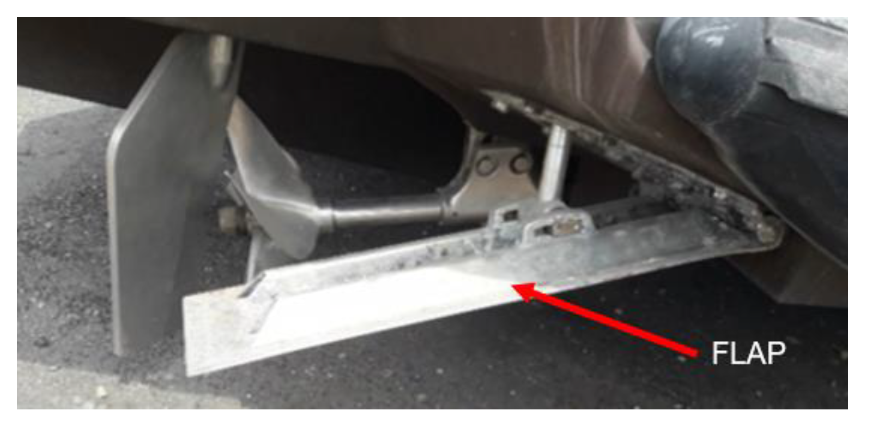
Flaps used for HSC
Forces equilibrium (Savistky & Brown, 1976)
Flaps characteristics (Skaki & Ghassemi, 2019)
20th Internatinoal Conference on Ship and Maritime Research
Genova – La Spezia, 15 – 17 June 2022

Slide 7
Optimization procedure
Problem definition
Non-dominated Sorting Genetic Algorithm (NSGA-II), (Deb et al 2002)
The objective function combines: Resistance ( Savitsky’64 + waves’76 + whisker spray’2007 + flaps effects) and, Acceleration: SavitskyBrown’76
Main components of Total weight are estimated using parametric equations.
The aim is to minimize resistance, f₁(x), and acceleration, f₂(x), of the vessel:
The design variables and constraints considered at conceptual level were:
20th Internatinoal Conference on Ship and Maritime Research
Genova – La Spezia, 15 – 17 June 2022

Slide 8
Optimization
procedure
Algorithm
implementation
20th Internatinoal Conference on Ship and Maritime Research
Genova – La Spezia, 15 – 17 June 2022

Slide 9
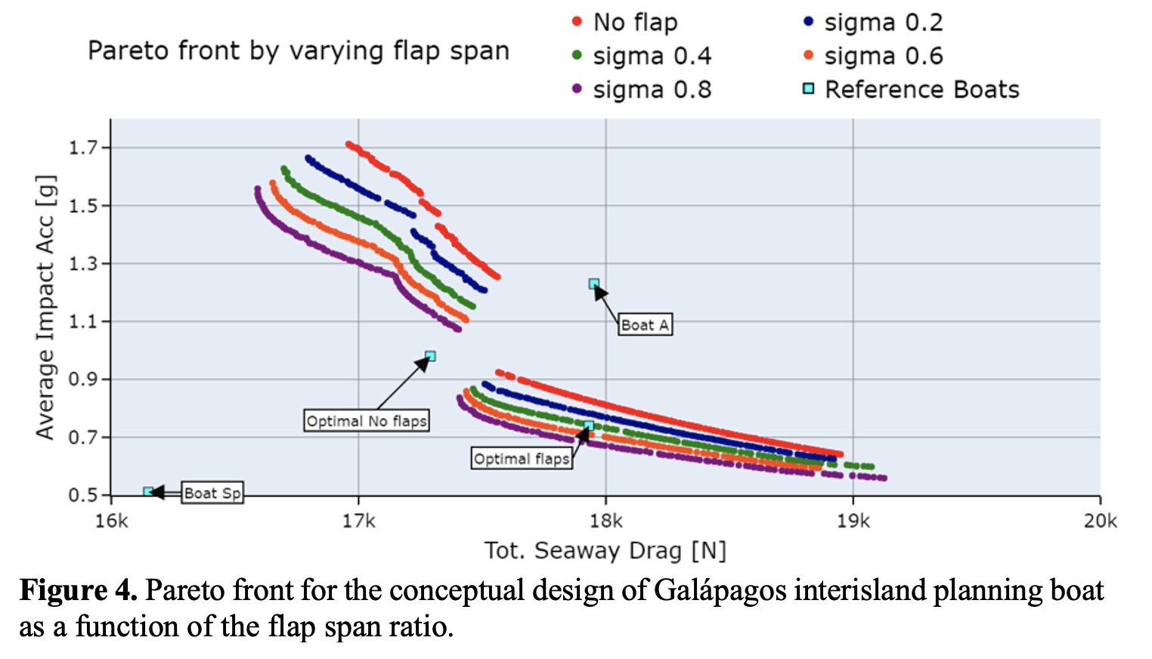
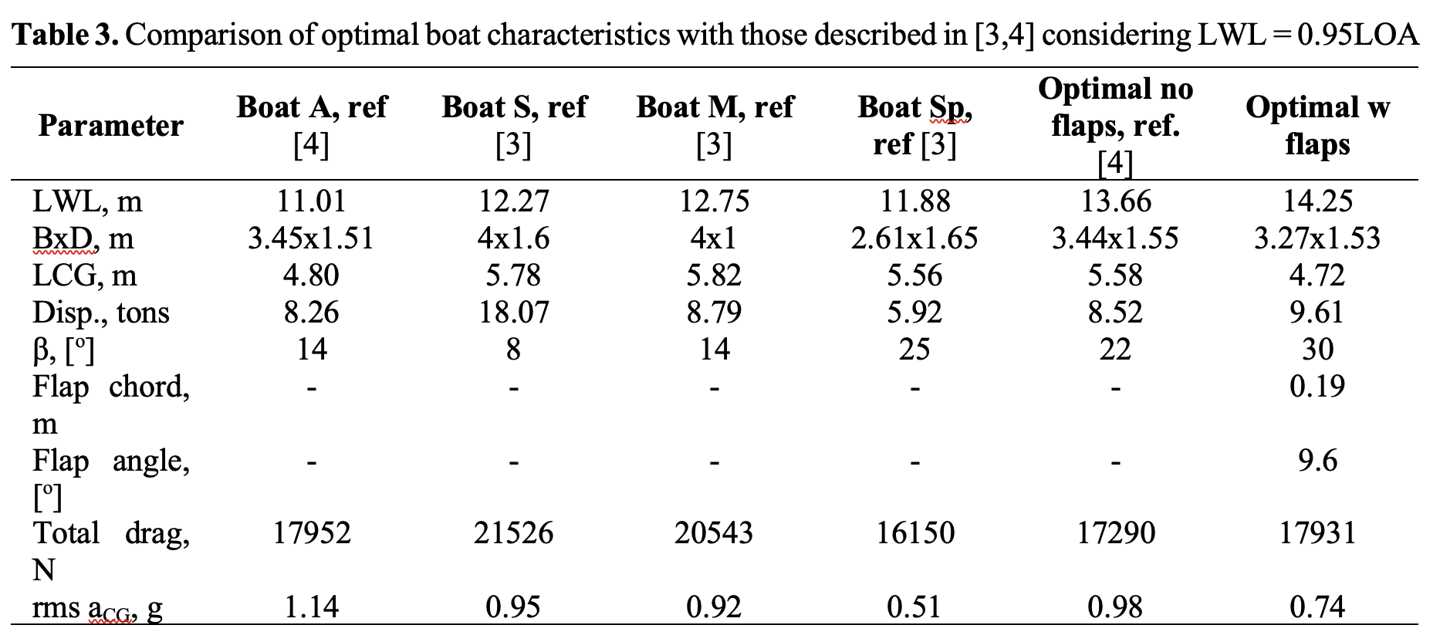
Results
Flap span ratio effect
20th Internatinoal Conference on Ship and Maritime Research
Genova – La Spezia, 15 – 17 June 2022

Slide 10
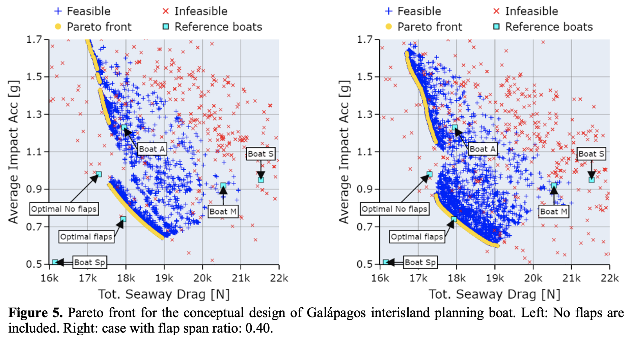
Results
20th Internatinoal Conference on Ship and Maritime Research
Genova – La Spezia, 15 – 17 June 2022

Slide 11
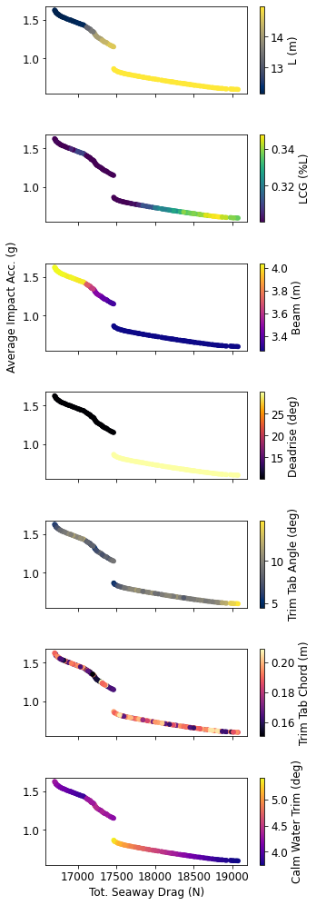
Results
Optimal Design variables values
Pareto front for the conceptual design of Galápagos interisland planning boat, flap span ratio: 0.40, and optimal design variables.
20th Internatinoal Conference on Ship and Maritime Research
Genova – La Spezia, 15 – 17 June 2022

Slide 12
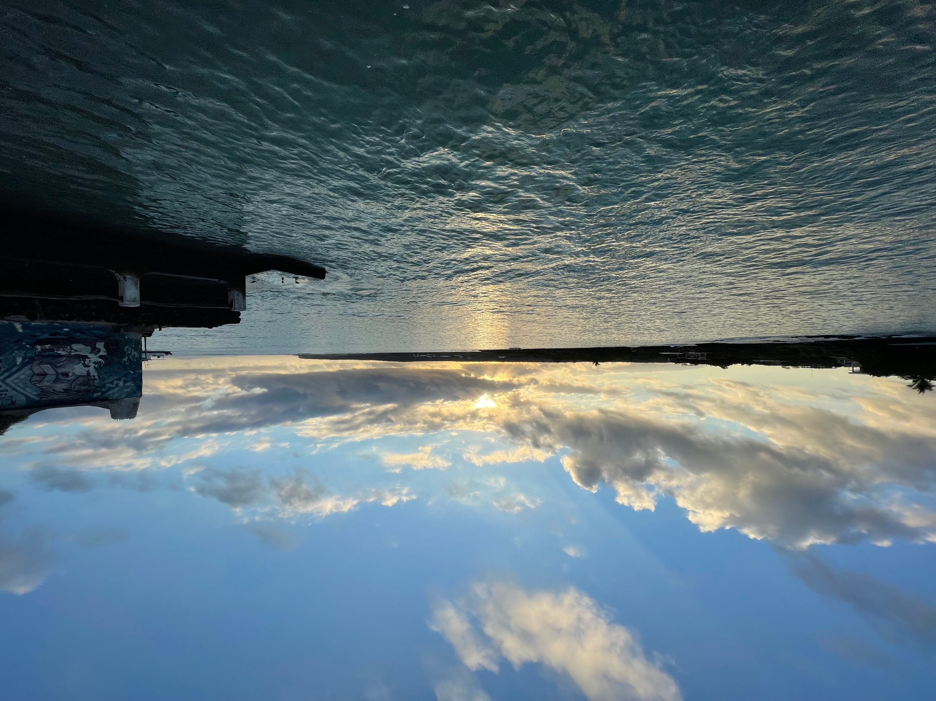
Conclusions
An evolutionary optimization procedure was implemented to reduce the vessel resistance, and acceleration at conceptual level.
LCG, deadrise angle and flap deflection angle have strong influence on the vertical acceleration of the boat CG.
This influence is more pronounced when those variables are about d∼10°, β∼30° and LCG∼35%L.
It is possible to reduce the acceleration by up to 45% and resistance by 7% with respect to the reference boat A operating in a Sea State 3 at Galapagos archipelago.
Academy bay, Santa Cruz
20th Internatinoal Conference on Ship and Maritime Research
Genova – La Spezia, 15 – 17 June 2022

Slide 13
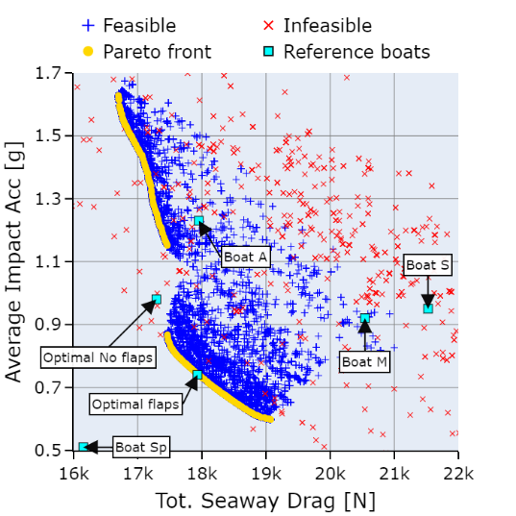
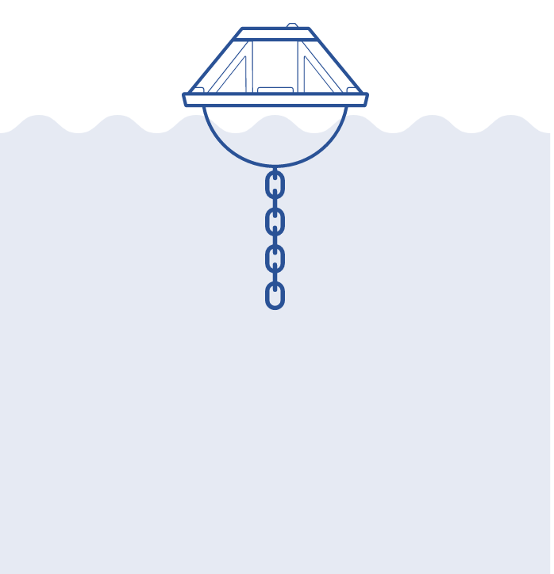
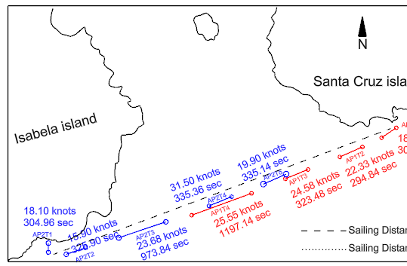
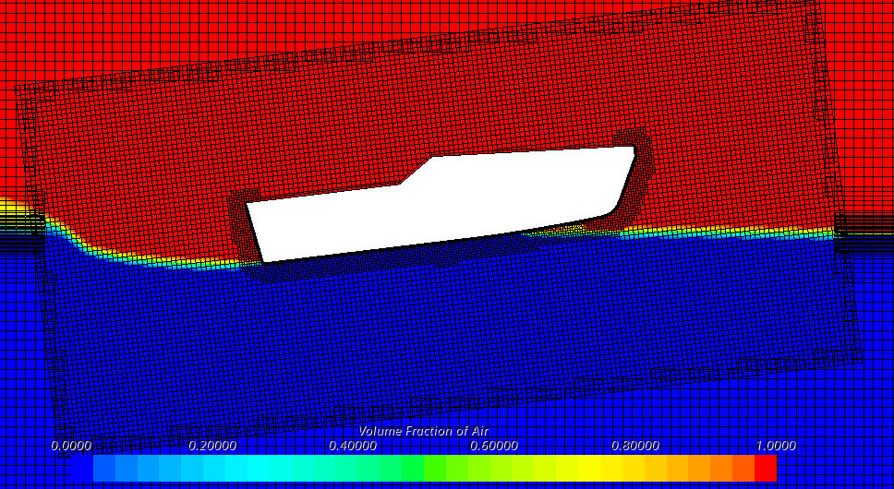
Future work
Currently working on:
Improve sea state estimation during sea trials using a wave buoy.
Replace accelerometers for 30Gs MEMS micromachined piezo-resistive.
Evaluate the influence of forward LCG position on dynamic stability (Blount and Codega,1992)
Task planned for 2022:
Estimation of EEOI.
CFD simulations using OpenFOAM.
Towing tank trial at Davidson Lab.
Exploring renewable energy sources for propulsion system.
Design zero emission propulsion system at construction level.
20th Internatinoal Conference on Ship and Maritime Research
Genova – La Spezia, 15 – 17 June 2022

Slide 14
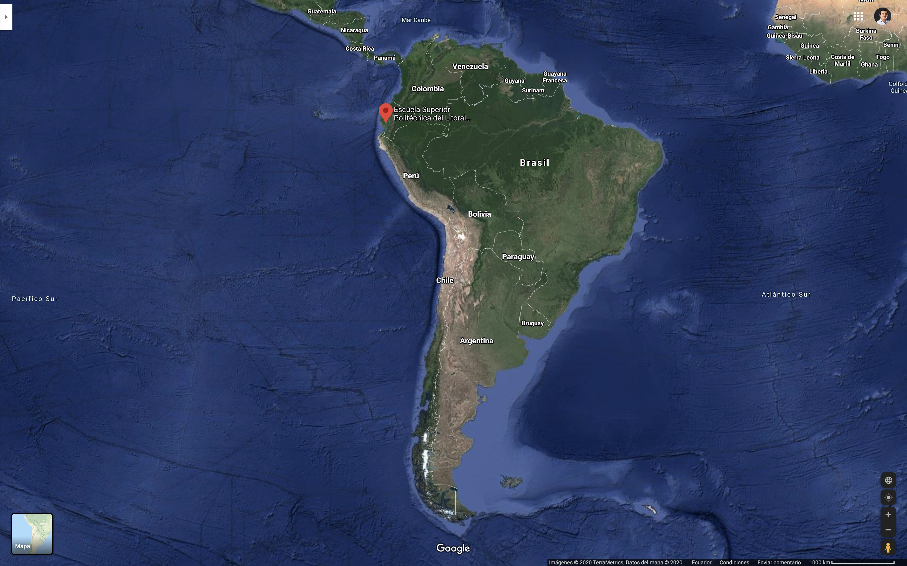
Thank you for your attention
Any question?
20th Internatinoal Conference on Ship and Maritime Research
Genova – La Spezia, 15 – 17 June 2022

