Slide 1
On the development of a ship simulation model for maneuvering tasks in waves
Maria ACANFORA*, Marco ALTOSOLE, Ernesto FASANO, and Davide LAURIA
*maria.acanfora@unina.it
Industrial Engineering Department, Università degli studi di Napoli “Federico II”, Naples, Italy

Slide 2
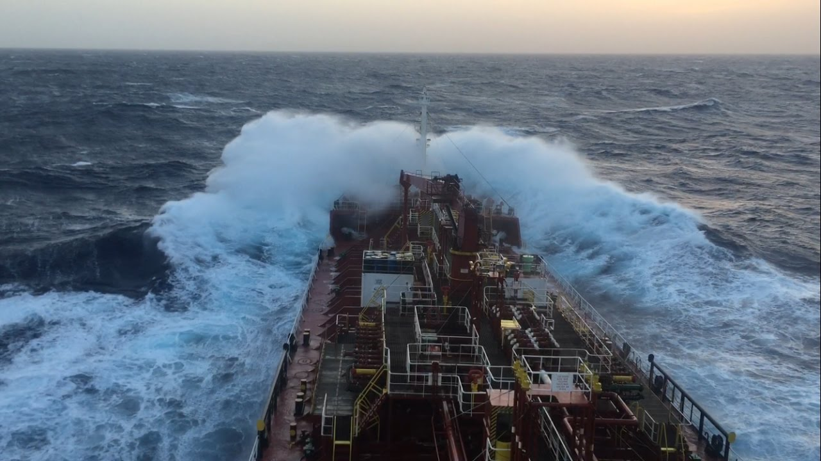
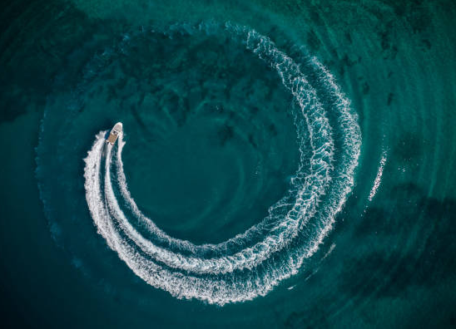
Layout of the presentation
Introduction
Numerical model for the hull dynamics in waves
Case study
Results
Conclusions

Slide 3

I. Introduction
Motivation
Interest of the Maritime Industry in greener propulsion systems on-board
Novel hybrid propulsion systems to be designed and adopted
Needs of dynamic simulation for characterizing beforehand the behaviour of such systems in the marine environment (wind, wave, currents, etc…)
A good simulator for ship manoeuvring in waves, with the possibility of including propeller and engine models is expected

Slide 4
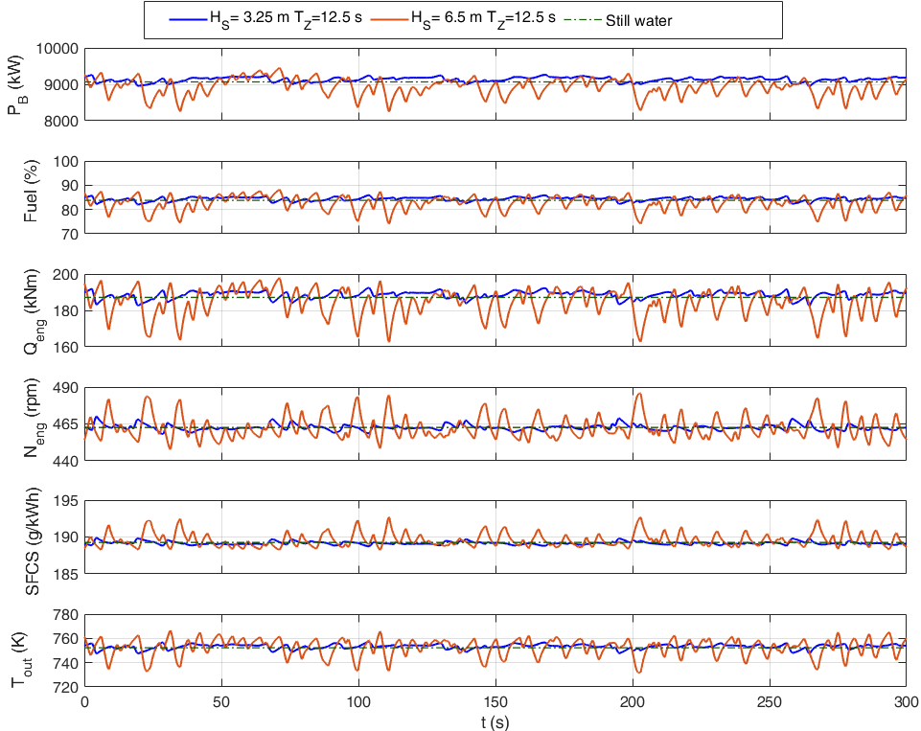
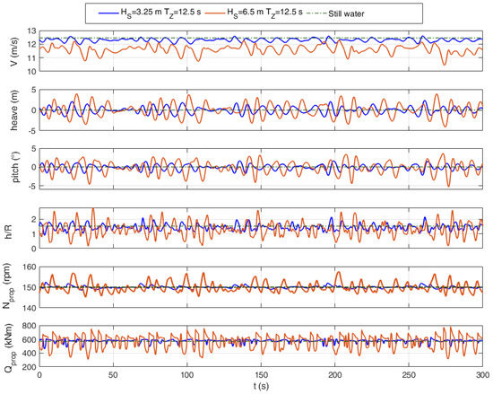
I. Introduction
A previous research regarded the coupling between the dynamics of a ro-pax in irregular waves (straight runs) and a marine diesel engine behaviour. M. Acanfora, M. Altosole, F. Balsamo, L. Micoli, and U. Campora, “Simulation Modeling of a Ship Propulsion System in Waves for Control Purposes,” JMSE 2022.
The current research aims at implementing manoeuvring models in waves, on a VLCC (data available for comparisons)

Slide 5
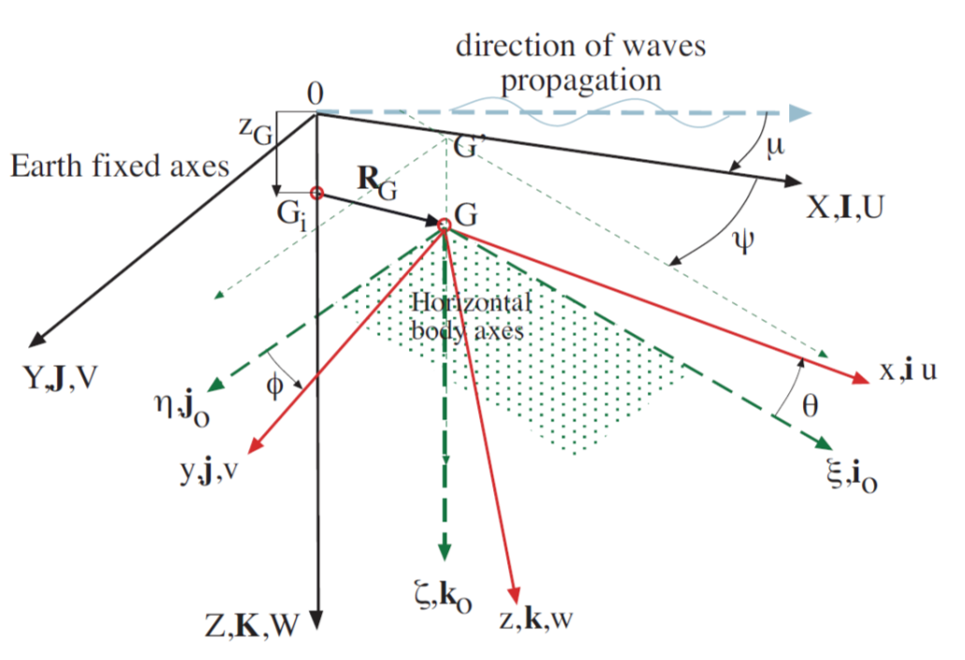
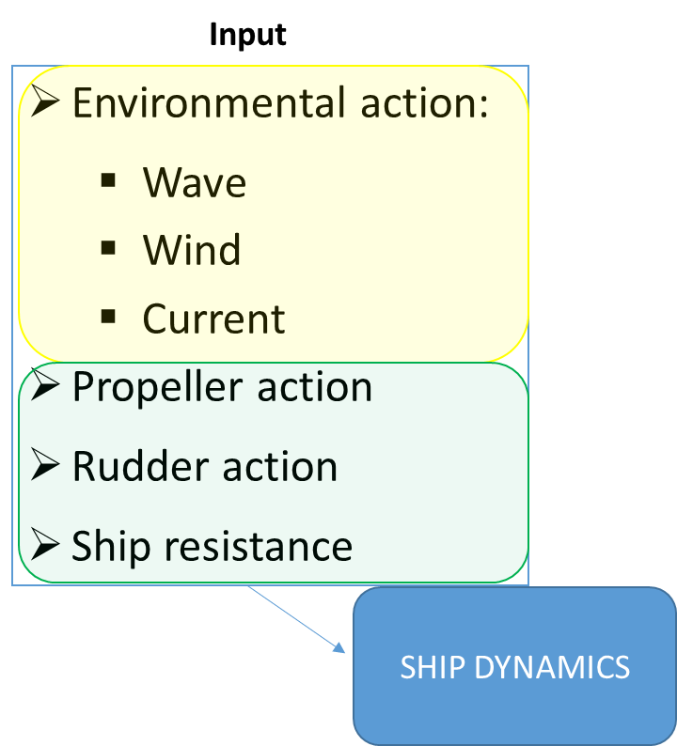
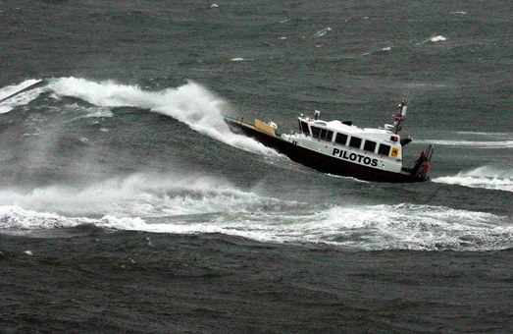

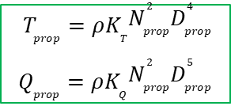
II. Numerical model for the hull dynamics in waves
Numerical model in time domain, 6DoF
So-called blended (or hybrid) numerical model for ship dynamics in wave:
  The inertia, Froude-Krylov and restoring forces and moments are evaluated accounting for all the relevant non-linearities
  Convolution integral approach for added mass and damping effects
  Linear diffraction and radiation forces and moments
Numerical modelling of propeller actions and ship resistance
Numerical modelling of ship rudder and manoeuvring actions
$$T_{prop}=ρK_{T}N_{prop}^{2}D_{prop}^{4}$$
$$Q_{prop}=ρK_{Q}N_{prop}^{2}D_{prop}^{5}$$
$$X_{res}=\frac{1}{2}ρV_{S}^{2}S C_{T}$$

Slide 6
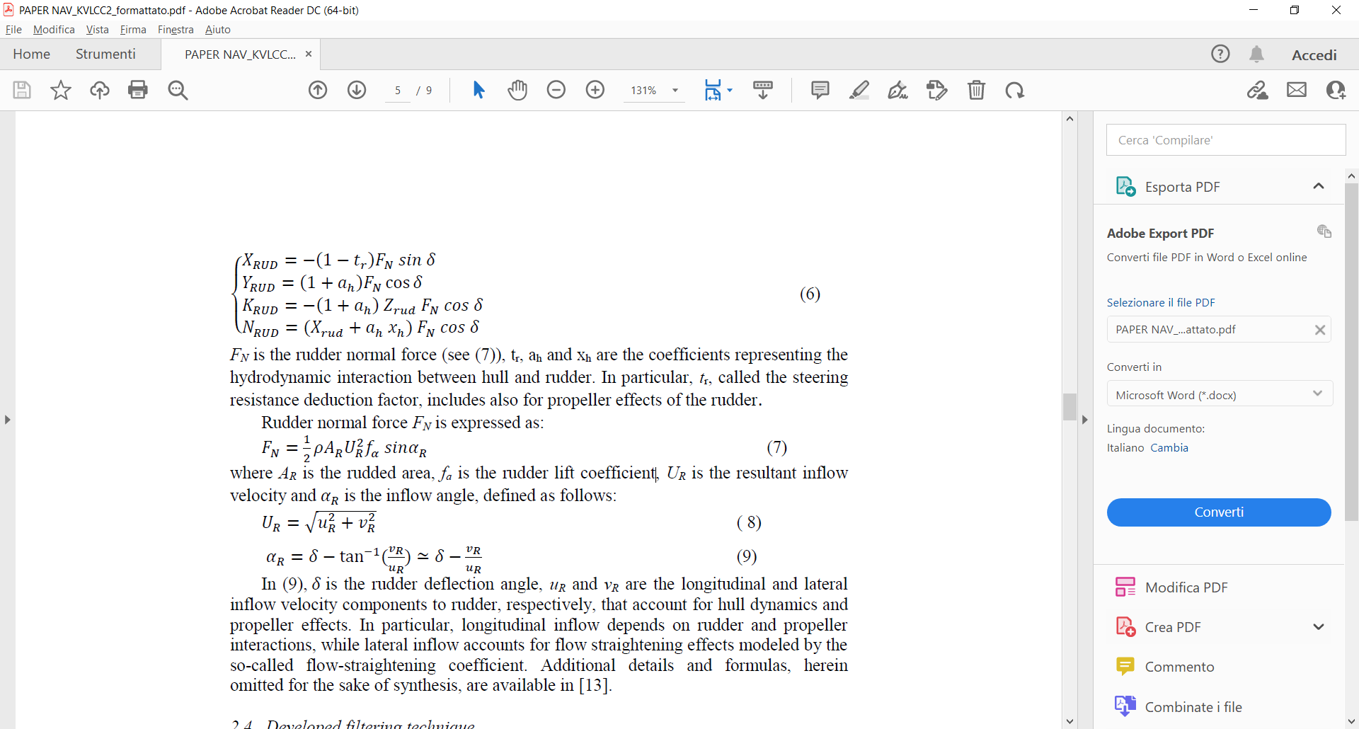
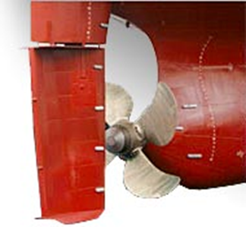
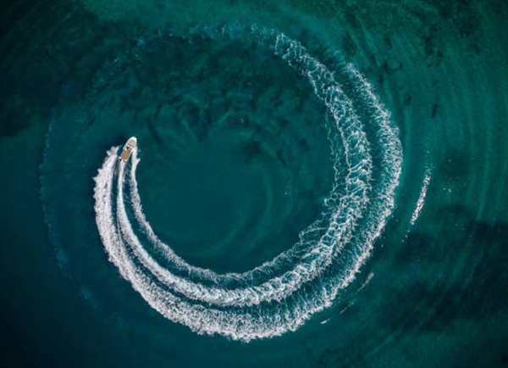
II. Numerical model for the hull dynamics in waves
Numerical modelling of rudder and maneuvering actions
MMG model for the steering actions
Non-linear model of ship manoeuvring
Only relevant derivatives are kept
Derivatives refer to yaw and sway
speed components
The manoeuvring in waves is
implemented by the so-called direct superposition approach
The model accounts also for effects on roll due to manoeuvring
The MMG model bases on the knowledge of pertinent experimental coefficients for the estimation of steering actions
t_{r}, a_{h} and x_{h} are the coefficients representing the hydrodynamic interaction between hull, rudder and propeller
Notes:
Wave effects on rudder: non constant speed components
Wave effects on manuvering: withdrawn of seakeeping potential damping components in sway/yaw directions

Slide 7
II. Numerical model for the hull dynamics in waves
Proposal for a novel modeling of maneuvering actions in waves:
→Zero-delay decomposition of yaw and sway speed components within the time domain
simulation (by combining the exponential smoothing approach with a proper transfer function)
Low frequency part is associated to manoeuvring coefficients
High frequency part is associated to seakeeping coefficients
Notes:
Wave effects on rudder: non constant speed components
Wave effects on manuvering: withdrawn of seakeeping potential damping components in sway/yaw directions

Slide 8
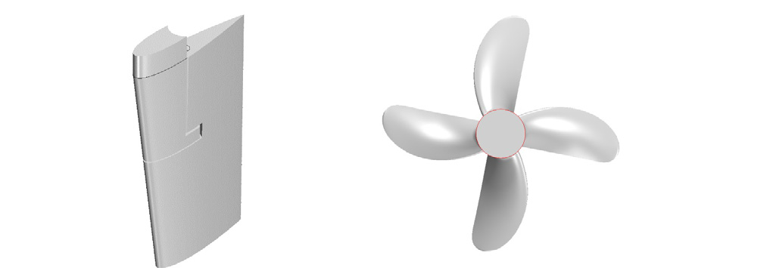
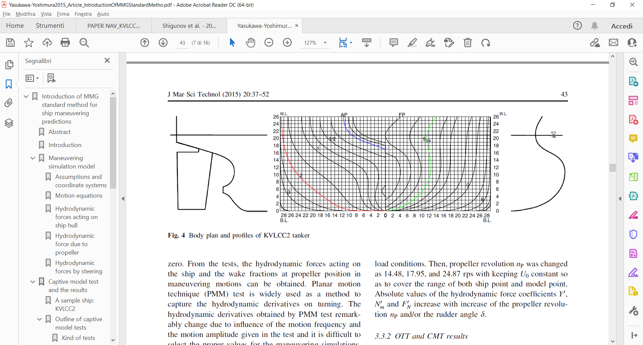
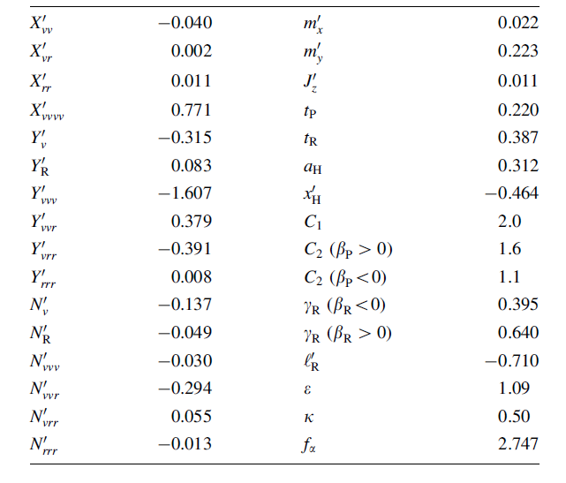
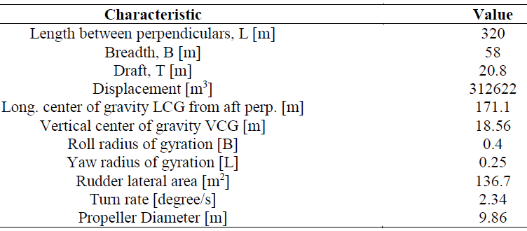
III. Case study
The KVLCC2 is a very large crude carrier developed by the KRISO towing tank for research purposes.
AVAILABLE INPUT DATA:
Hull lines
Rudder and propeller geometry
Propeller coefficient curves in still water
Maneuvering derivatives in still water
Steering action coefficients for the MMG
model in still water
https://www.simman2014.dk
Notes:
Ship resistance in still water derived by limited information available

Slide 9
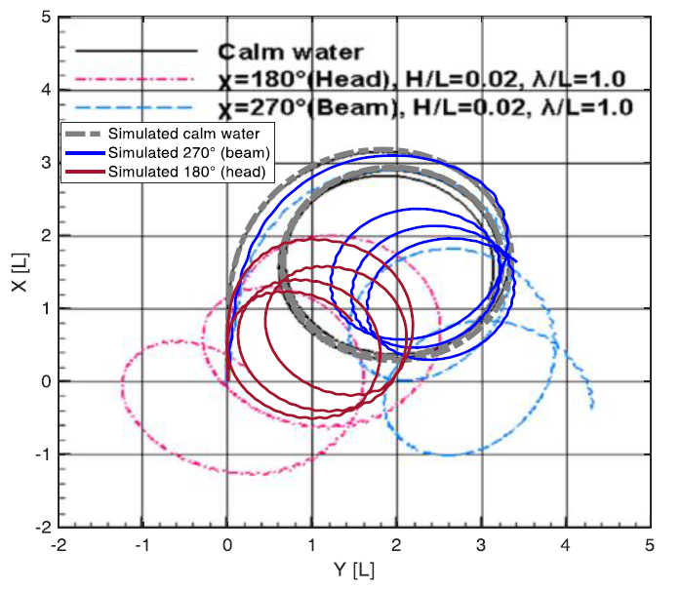
IV. Results
Turning circle in head and beam waves to starboard side, rudder deflection 35°: direct superposition approach
Still water simulation finely matches the experimental data
Regular wave simulations of the turning circle appear sufficiently fine if we consider the following aspects:
  Qualitative agreement of the turning radius
  Qualitative agreement of the drifting directions, consistent with the wave directions (both in head and in beam waves)
  An additional turn is observed compared to the experimental data, given the same simulation time

Slide 10
IV. Results
Turning circle in head waves to port side, rudder deflection 35°, direct superposition approach: increasing wave height
  In the experimental data the drifting distances increase with increasing wave height
  Qualitative agreement of the increase in drifting distances with increasing wave height in the numerical simulation
  Qualitative agreement of turning radius for all cases
  Fair matching of turning path especially for the smaller wave height case

Slide 11
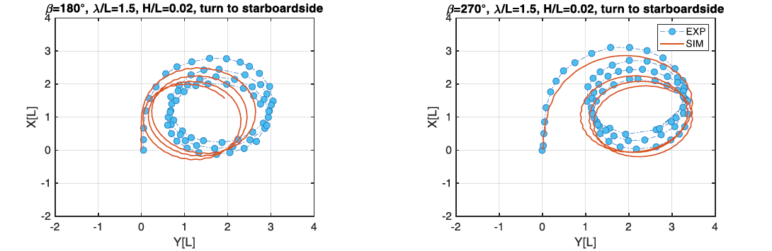
IV. Results
Turning circle in head waves to starboard side, rudder deflection 35°, direct superposition approach, longer waves
  In the experimental data the drifting distances reduce with increasing wave length
  Qualitative agreement in drifting distances with increasing wave height in the numerical simulation
  Qualitative agreement in the turning radius
  An overall better agreement is found for the beam sea case

Slide 12
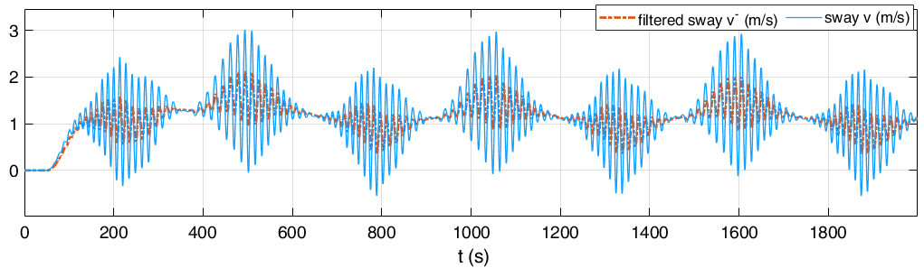
IV. Results
Turning circle in head waves to port side, rudder deflection 35°, comparison between direct superposition vs zero-delay filtering
The new approach based on speed filtering shows:
a certain improvement in modelling the initial part of the turning circle
a better agreement in the drifting distances, in spite of somewhat smaller turning diameters
The implemented filtering technique ensures a zero delay filtered signal, although there are still high frequency components

Slide 13
IV. Results
DISCUSSIONS
  Simulations were carried out for long waves (λ/L=1 and λ/L=1.5): the range of applicability of the numerical model for ship resistance in waves reasonably limits to the sea states characterized by wave length greater than ship length, where radiation and diffraction actions are not predominant.
  Ship speed, for λ/L=1, is overestimated of almost 10% in straight run simulations: this might be responsible for the observed additional turn.
  Ship resistance curve in still water was derived as quadratic extrapolation from a limited amount of points!
λ/L | exp (knots) | sim (knots) | error (knots) | err %
0.5 | 12.1 | 15.3 | 3.2 | 26%
0.7 | 10.9 | 15.1 | 4.2 | 39%
1 | 8.6 | 9.5 | 0.9 | 10%
1.2 | 10.2 | 9.2 | -1 | -10%
1.5 | 12.6 | 11.6 | -1 | -8%
M. Acanfora, M. Altosole, F. Balsamo, L. Micoli, and U. Campora, “Simulation Modeling of a Ship Propulsion System in Waves for Control Purposes,” JMSE 2022

Slide 14
Conclusions
  A numerical model for ship manoeuvring in waves was applied to a large tanker for the estimation of the turning circle paths.
  The comparison with the experimental data confirmed a fair accuracy of the model for increasing wavelengths.
  A consistent agreement in the drifting directions due to the different wave conditions under investigation was always appreciable.
  The developed approach, based on signal decomposition by means of exponential smoothing, proved to have a certain improvement for the turning circle case where it was applied.
  Although there are several acknowledged limitations in the numerical model, the presented outcomes are in the same range of accuracy of other models dealing with the numerical simulation of turning circle of large vessels in regular waves (see V. Shigunov, O. el Moctar, A. Papanikolaou, R. Potthoff, and S. Liu, “International benchmark study on numerical simulation methods for prediction of manoeuvrability of ships in waves,” Ocean Eng., vol. 165, pp. 365–385, Oct. 2018; R. Suzuki, M. Ueno, and Y. Tsukada, “ ,” Appl. Ocean Res., vol. 113, p. 102732, Aug. 2021.)

Slide 15

THANK YOU FOR YOUR ATTENTION
QUESTIONS

