Slide 1





A digital twin approach to the diagnostic analysis of a marine diesel engine
Marco ALTOSOLE, Flavio BALSAMO, Maria ACANFORA
Dept. of Industrial Engineering, University of Naples “Federico II”, Italy
Ugo CAMPORA
Dept. of Mechanical, Energy, Management, Transport Engineering (DIME),
University of Genoa, Polytechnic School, Italy
Luigia MOCERINO
Department of Science and Technology, University of Naples “Parthenope” , Italy
Francesco PERRA
Cetena S.p.A, Genova, Italy

Slide 2




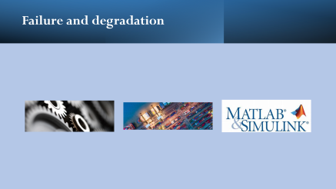

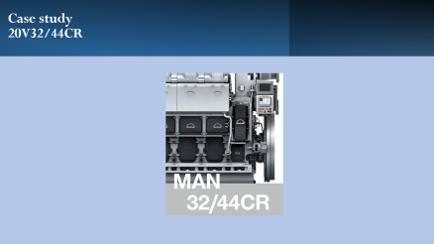
Agenda
NAV 2022, A digital twin approach to the diagnostic analysis of a marine diesel engine

Slide 3

Aim and scope

Slide 4
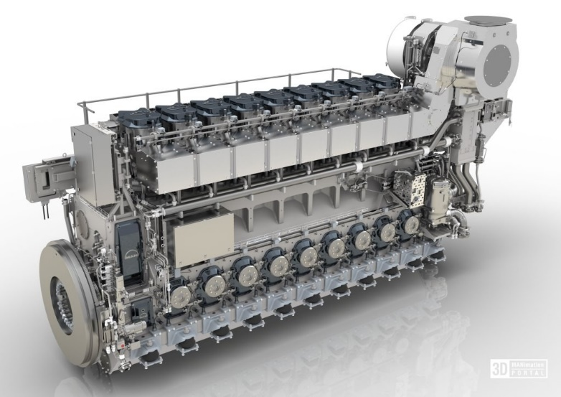
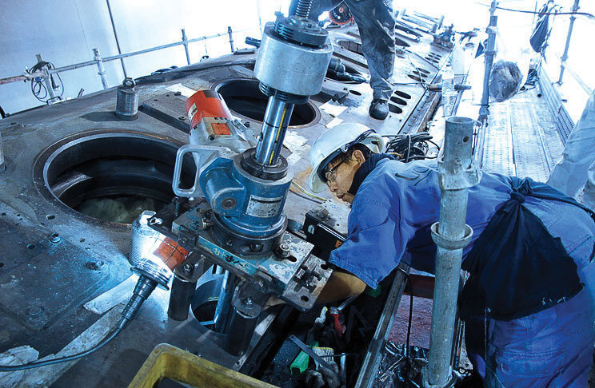

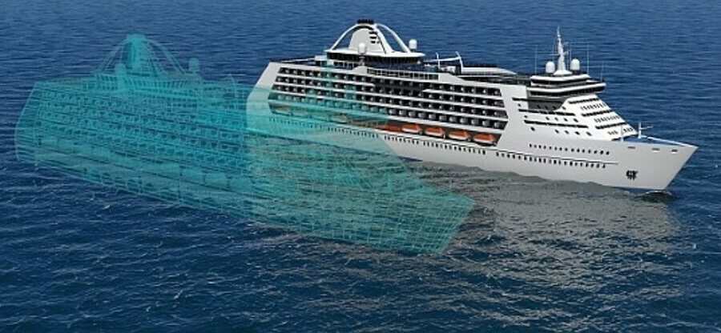
Aim and scope
NAV 2022, A digital twin approach to the diagnostic analysis of a marine diesel engine
A regular and proper preventive maintenance program plays a fundamental role in guaranteeing ship operability and safety
This is the case of internal combustion engines, in which complex mechanical and mainly thermodynamical phenomena that cannot be easily monitored occur.
To overcome these difficulties the digital twin approach is thought of as a useful and promising technique to get an estimate of the engine working parameters
Notes:
Among the different methods, PM is the most recent and promising technique to reduce the risk that a system failure occurs before a maintenance intervention; these methodologies are based on the assumption that generally, a component failure happens after a preliminary phase of incipient degradation during which one or more operating parameters start to deviate slightly from the expected values. The duration of this phase ranges from months to a few minutes. In the case of complex systems, a prompt identification of such deviations requires measurements that are often impossible or at least very expensive

Slide 5
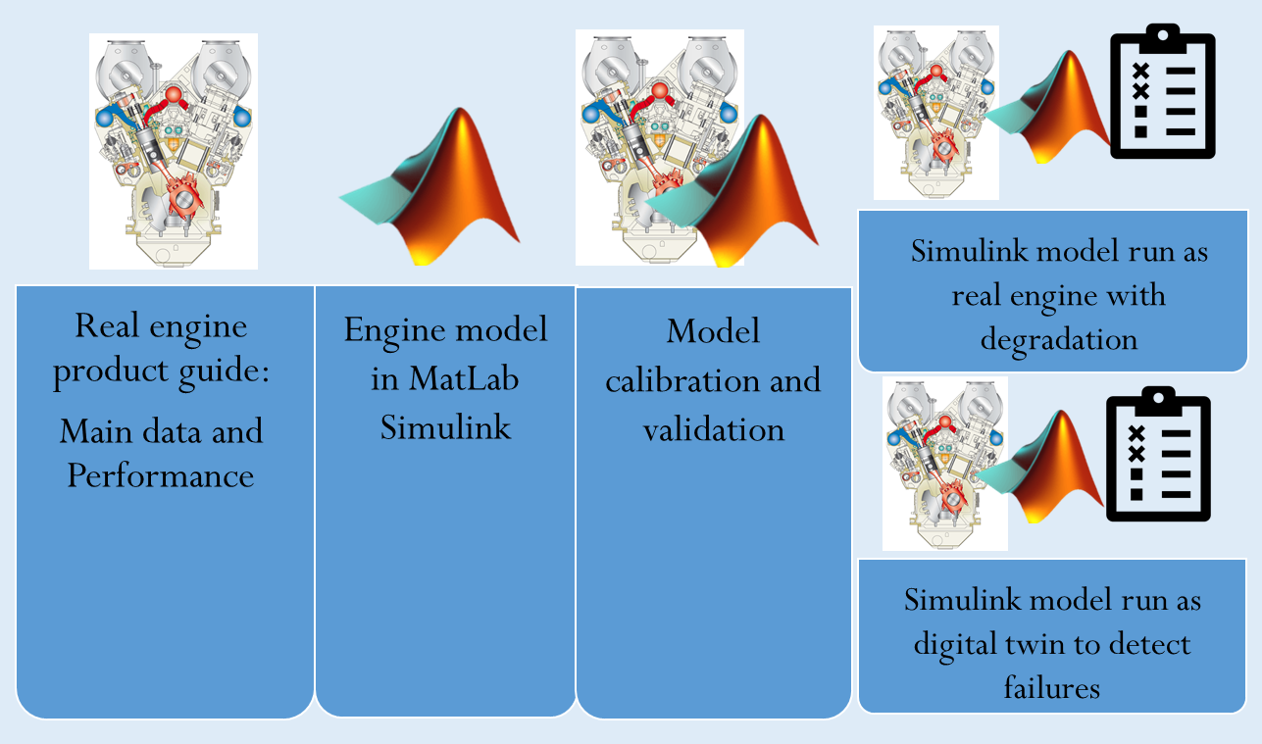
Aim and scope
NAV 2022, A digital twin approach to the diagnostic analysis of a marine diesel engine
A computer model simulation of the engine is performed and the outcomes are continuously compared with the corresponding direct measurements.
To build a reliable engine digital model
The development of an effective identification procedure.
During the preliminary stage, the full-scale setup and testing of the procedure are unpractical for evident reasons, therefore the experimental data in degraded operating modes are generated by an accurate and detailed computer model of the real engine
The effects of several typical degradations of a ship’s engine have been supposed and analyzed to their detection at an early stage by processing some parameters that can be monitored on board

Slide 6

Engine model

Slide 7
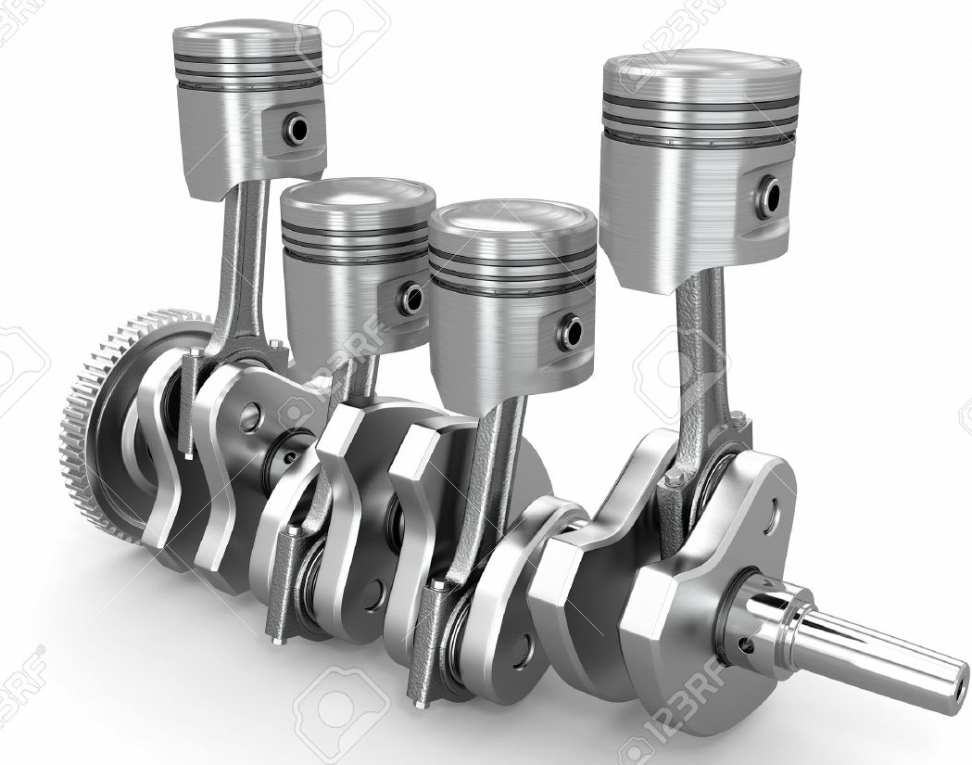
Engine model logic
NAV 2022, A digital twin approach to the diagnostic analysis of a marine diesel engine
Mass of fuel and rpm
air mass flow
INLET MANIFOLD
&
INTERCOOLER
Cylinder inlet
temperature
and pressure
Engine delivered torque
Cylinders gas mass flow
Cylinder outlet temperature and pressure
EXHAUST
MANIFOLD
Compressor outlet pressure and temperature
Compressor inlet air mass flow
TURBOCOMPRESSOR
& SHAFT DYNAMICS
Turbine inlet temperature
Turbine outlet gas mass flow
Exhaust gas manifold outlet pressure

Slide 8
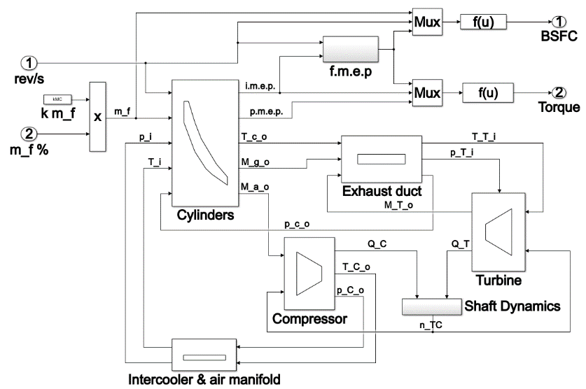
Engine model
NAV 2022, A digital twin approach to the diagnostic analysis of a marine diesel engine
A filling and emptying approach is applied to each engine simulator block.
The in-cylinder phenomena calculation is based on a fully thermodynamic actual cycle.
Turbocharger behavior is simulated by 4 numerical 2D tables extrapolated from the manufacturer’s datasheet.
The Shaft Dynamics block has in input the turbine and compressor torque.
The engine governor senses the engine speed and controls the fuel flow to maintain the required speed
Notes:
As output the fuel mass flow percentage injected in the cylinders.

Slide 9
Engine model
NAV 2022, A digital twin approach to the diagnostic analysis of a marine diesel engine
Fluid mass and energy continuity and the energy dynamic equations
ρ, U, V are the gas density, specific internal energy and volume respectively; M_{i} (H_{i}) and M_{o} (H_{o}) are the mass flow rate (the specific enthalpy) at the inlet and outlet section; M_{f} and H_{f} respectively the fuel mass flow rate and lower heating value; Φ the heat flow and P the mechanical power.
The turbocharger shaft dynamics
ω is the angular velocity; J is the total moment of inertia; Q’_{T} and Q’_{C} are the turbine and compressor torque
At each calculation step dϑ, the heat released in the combustion process
dm_{b} is the fuel mass burned obtained by multiplying the total fuel mass/cycle by the fuel mass burned/dϑ (Wiebe equation).

Slide 10
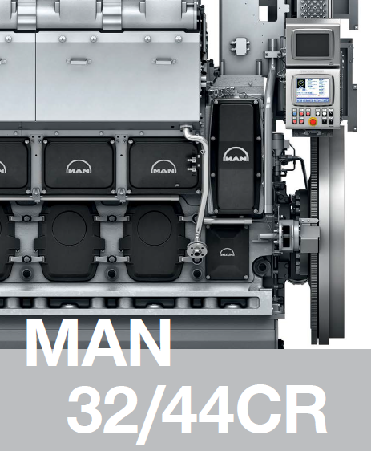
Case study
20V32/44CR

Slide 11

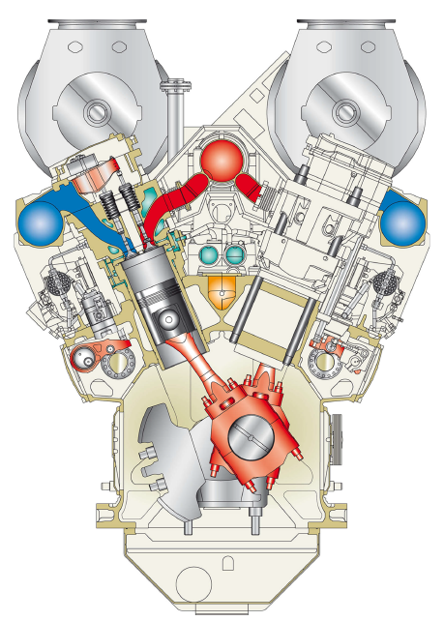
Case study: MAN 20V32/44CR
NAV 2022, A digital twin approach to the diagnostic analysis of a marine diesel engine
Engine characteristics | Values | Units
Power | 12000 | kW
Highest engine operating speed | 750 | rpm
Mean piston speed | 11 | m/s
Number of cylinders | 20 | -
Bore | 0,32 | m
Stroke | 0,44 | m
Displacement per cylinder | 35,4 | l
Connecting rod length | 1003,5 | mm
Crankshaft diameter | 320 | mm
Crankshaft diameter at the crank pin | 290 | mm
Air temperature before the turbocharger | 298 | K
Total atmospheric pressure | 100 | kPa
Relative humidity | 30 | %
Cooling water temperature inlet charge air cooler | 298 | K
Charge air pressure | 5,15 | bar (abs)
Exhaust gas backpressure after the turbocharger | 5 | kPa
NO_{X} | 8.0 – 16.0 | g/kWh
CO₂ | 560 – 620 | g/kWh
CO | 0.4 – 0.8 | g/kWh
Main data
Geometry
Initial condition
Emissions

Slide 12
Case study: MAN 20V32/44CR
NAV 2022, A digital twin approach to the diagnostic analysis of a marine diesel engine
Specific fuel consumption at constant speed
Engine load | Power | Specific fuel consumption | Charge air pressure | Temperature after compressor | Airflow rate | Exhaust flow rate | Temperature after turbine
[-] | [kW] | [g/kWh] | [bar] | [K] | [kg/s] | [kg/s] | [K]
1 | 12000 | 175,5 | 5,2 | 520,15 | 21,67 | 22,3 | 592,15
0,85 | 10200 | 174 | 4,44 | 488,15 | 18,47 | 19,55 | 587,15
0,75 | 9000 | 178 | 4,57 | 486,15 | 18,15 | 18,63 | 588,15
0,65 | 7800 | 179 | - | - | - | - | -
0,5 | 6000 | 182 | 2,96 | 431,15 | 13,3 | 13,63 | 596,15
0,25 | 3000 | 194 | - | - | - | - | -

Slide 13
Case study: MAN 20V32/44CR
NAV 2022, A digital twin approach to the diagnostic analysis of a marine diesel engine
Specific fuel consumption at variable speed
rpm | Power | Specific fuel consumption
[rpm] | [kW] | [g/kWh]
750 | 12000 | 175,5
710 | 10200 | 173,5
683 | 9000 | 180,0
600 | 6000 | 187,0

Slide 14
Validation

Slide 15

Simulations at constant speed of power
and specific fuel consumption
NAV 2022, A digital twin approach to the diagnostic analysis of a marine diesel engine
750 rpm

Slide 16
Simulations at variable speed of power
and specific fuel consumption
NAV 2022, A digital twin approach to the diagnostic analysis of a marine diesel engine

Slide 17
Errors
NAV 2022, A digital twin approach to the diagnostic analysis of a marine diesel engine
 | Engine load | 1 | 0,85 | 0,75 | 0,65 | 0,5 | 0,25
Constant speed | Specific fuel consumption error (%) | 0,45% | 0,36% | -0,66% | -0,12% | -0,55% | 0,39%
Variable speed | Specific fuel consumption error (%) | 0,45% | 0,73% | -0,62% | - | -0,45% | 0,16%
4,0%
5,5%
2,8%
4,0%

Slide 18


Failure and degradation
Notes:
At this stage of the research, to make up for the lack of experimental data recorded onboard both in normal and degraded mode, a more detailed engine simulator is used to generate onboard data, with some alterations to the operating conditions The state of the engine is evaluated by analyzing the offset between the parameters of the degraded model and those obtained through the identification procedure for the degraded case.

Slide 19





Failure and degradation: setup
NAV 2022, A digital twin approach to the diagnostic analysis of a marine diesel engine
Simulation block | Degradation | Range of degradation | Legend
Intercooler | Intercooler fouling | [0-10%] | d_in_p
Intercooler | Efficiency reduction | [0-20%] | d_in_eff
Compressor | Dirty air filter | [0-10%] | d_co_eff
Compressor | Efficiency reduction | [0-10%] | d_co_re
Compressor | Mass flow reduction | [0-10%] | d_co_m
Shaft TG | Bearing deterioration | [0-5%] | d_tg_cu
Turbine | Efficiency reduction | [0-10%] | d_t_re
Turbine | Erosion or fouling of the blades | [± 5%] | d_t_pa
Cylinder | Fuel flow reduction | [0-10%] | d_c_co
Cylinder | Alteration of injection angle | [± 5^{O}] | d_c_ang
Degradation (j)
Simulation Block (i)
Results
Failures detection

Slide 20
Failure and degradation: results
NAV 2022, A digital twin approach to the diagnostic analysis of a marine diesel engine
ID | Intercooler (I) and Compressor (C) | ID | Turbine (T) and exhaust duct (D) | ID | Cylinder
1 | Outlet temperature (I) | 11 | Turbine efficiency (T) | 19 | i.m.e.p
2 | Compressor efficiency (I) | 12 | Turbine Mass flow (T) | 20 | Outlet temperature
3 | Compressor torque (I) | 13 | Exhaust flow (T) | 21 | Outlet pressure
4 | Outlet pressure (C) | 14 | Epsilon (T) | 22 | Exhaust mass flow
5 | Outlet temperature (C) | 15 | Turbine torque (T) | 23 | Air mass flow
6 | Mass flow (C) | 16 | Outlet pressure (T) | 24 | air/fuel ratio
7 | rpm (C) | 17 | Outlet temperature (T) | 25 | m.e.p
8 | beta (C) | 18 | rpm (T) | 26 | Power
 |  | 9 | Outlet pressure (D) | 27 | Consumption
 |  | 10 | Outlet temperature (D) | 28 | Engine torque
Air filter degradation
Notes:
ONLY MONITORED ON BOARD

Slide 21

Pressure
Temperature
Mass flow

Slide 22
Parameter estimation

Slide 23
Parameter estimation
NAV 2022, A digital twin approach to the diagnostic analysis of a marine diesel engine
The toolbox solves the problem of optimization of the error between the measured variable and the simulated variable by finding the solution of the optimal combination of the degradation coefficients.
The basic assumptions are based on the minimization of the mean square error by a nonlinear algorithm.
The application of this technique allows identifying the component degradation which causes a given realization of the monitored variables.
In the optimization procedure, the parameters suitably vary until their value produces numerical outcomes matching those of the degraded simulation (in this study, replaces the measured data onboard).
1
==
NO MALFUNCTION
Failure coefficients
<1
==
MALFUNCTION DETECTED

Slide 24
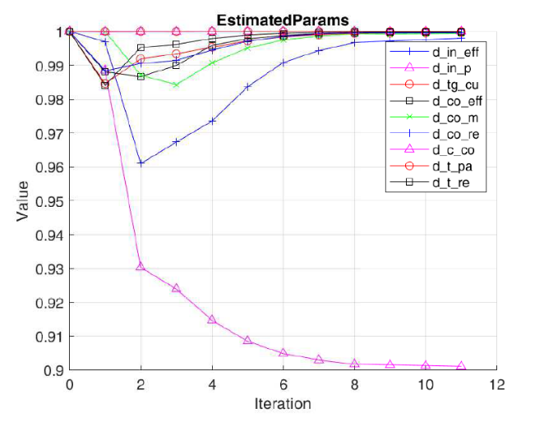
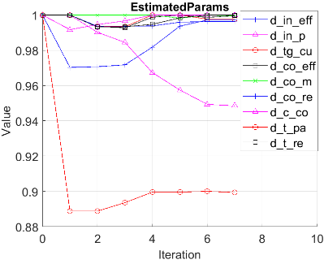
Parameter estimation results
NAV 2022, A digital twin approach to the diagnostic analysis of a marine diesel engine
Parameter estimation results for 1 degradation
Intercooler pressure loss [10%]
Parameter estimation results for 2 degradations
Intercooler pressure loss [5%]
Fouling on the turbine blades [10%]

Slide 25
Parameter estimation results
NAV 2022, A digital twin approach to the diagnostic analysis of a marine diesel engine
Degradation | Legend | Simulation | Parameter estimation results
Intercooler fouling | d_in_p | 0,9 | 0,9
Efficiency reduction | d_in_eff | 0,9 | 0,9
Dirty air filter | d_co_eff | 0,95 | 0,95
Efficiency reduction | d_co_re | 0,95 | 0,95
Mass flow reduction | d_co_m | 0,95 | 0,95
Bearing deterioration | d_tg_cu | 1,0 | 1,0
Efficiency reduction | d_t_re | 1,0 | 1,0
Erosion or fouling of the blades | d_t_pa | 1,05 | 1,05
Fuel flow reduction | d_c_co | 0,95 | 0,95
Alteration of injection angle | d_c_ang | 1,0 | 1,0

Slide 26
Conclusions
The paper describes the development of a digital twin model, integrated with a diagnostic numerical tool for the identification of possible degradations and failures of a marine diesel engine.
The diagnostic tool, based on a parameter estimation approach, can identify the engine malfunctions by comparing simulation and field data. Unfortunately, experimental values in degraded conditions are not yet available at this stage of the research, therefore, in the present application, they are estimated through the same simulation model.
The numerical procedure has been successfully tested in the identification of several simultaneous degradations
However, the positive results can probably also be attributed to using the same Matlab simulation model to represent both measured and simulated data. From this point of view, the diagnostic tool should be validated by using the field data derived from a different simulation model of the engine (at least until real experimental data are available).

Slide 27

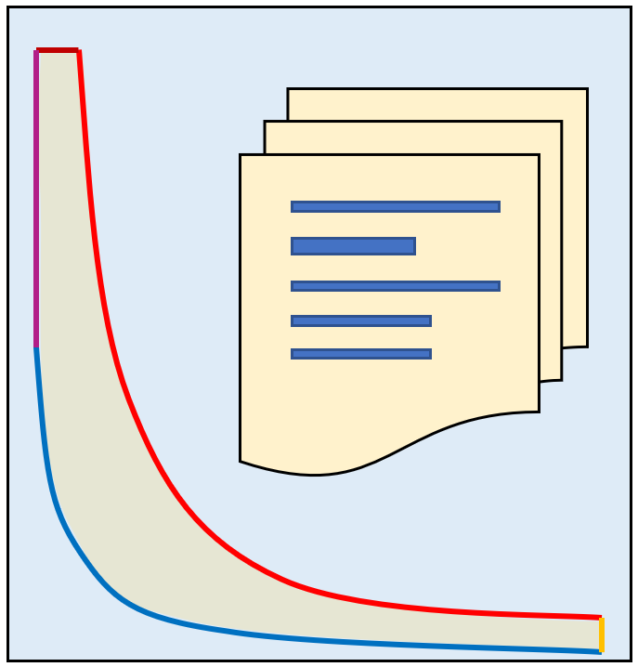




Next step
Engine product guide
Commercial software model run as real engine with degradation
Matlab
Simulink
Real engine product guide:
Main data and Performance
Engine model written in commercial software
Model calibration and validation
Commercial software
Simulink model run as digital twin to detect failures
Failures generation and detection

Slide 28
Thanks for the attention
Luigia MOCERINO
University of Naples “Parthenope”, Department of Science and Technology

