Slide 1
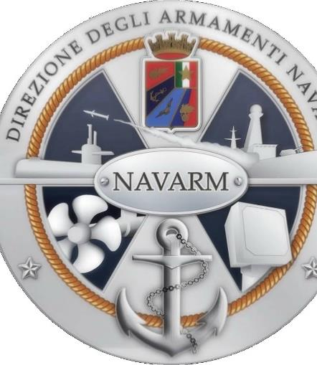
Near Future Submarine:
Development of a combined Air Indipendent and Lithium Battery propulsion system (AI-LiB PS)
NAV 2022 – June 16th – CPT (Eng) Decio TRINCA

Slide 2
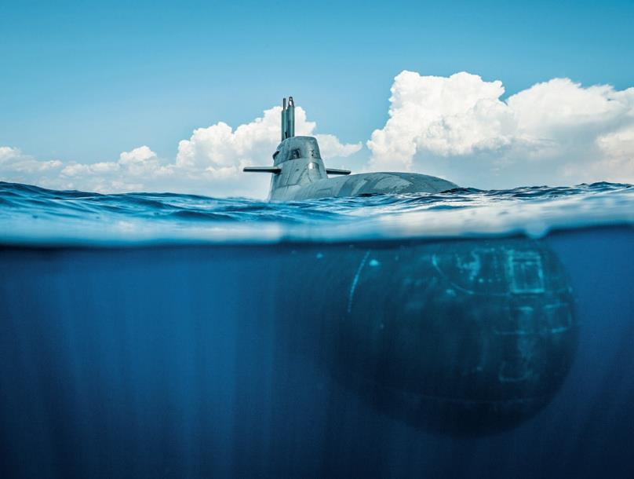
Bio
#SUBMARINER
#ENGINEER
Notes:
Before going straight to the core of my presentation, please, as a Submariner and Engineer, let me do some introductory considerations

Slide 3
AGE of AWARENESS
Notes:
Welcome to the age of awareness, because if it’s true that it’s easy to ignore what we cannot see, finally we are aware, after centuries of looking at the stars and dreaming about being an astronaut, that the unfamiliar depths of the sea, are everyday a more important part of human beings everyday life, in terms of resources, technology and safety.

Slide 4
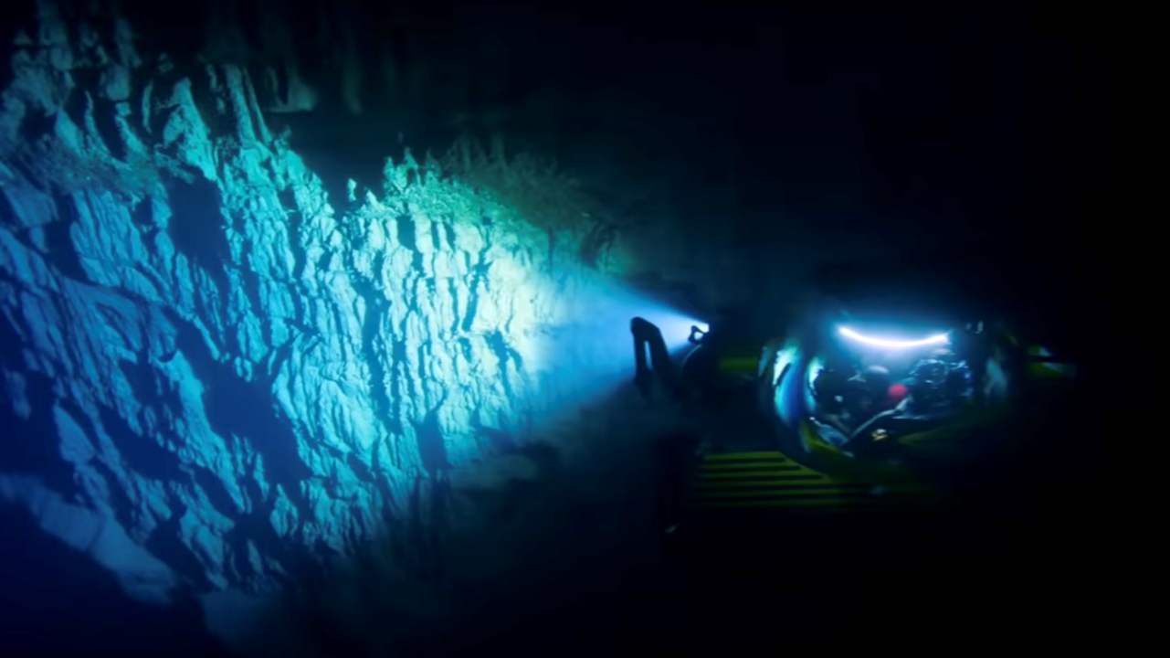
UNDERWATER DOMAIN
Notes:
The underwater domain has reached the same popularity of the space domain, in terms of will to explore and R&D focus

Slide 5
UNDERWATER NETWORK
Notes:
To understand the relevance of the underwater domain, just think that quite 99% of global data traffic passes through the submarine cable network, an infrastructure that spans about 1.2 million kilometers and through which $10 trillion financial transactions pass every day

Slide 6
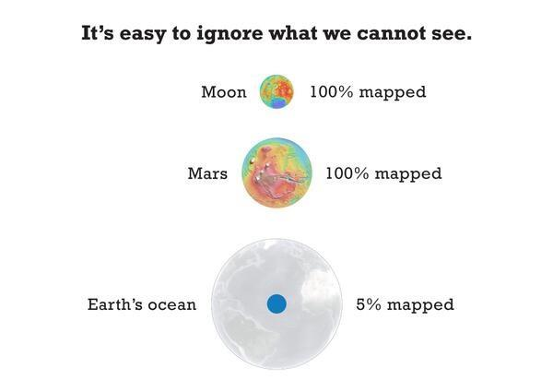
UNDERWATER MAPPING
Notes:
We have often been told that we know more about the surface of Mars or the moon than the depths of the ocean, and that 95% of the Earth’s Ocean in unmapped

Slide 7
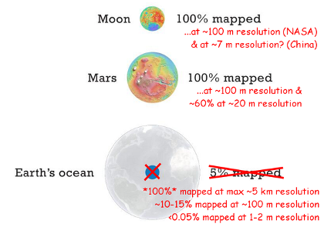
UNDERWATER MAPPING
Notes:
Actually this is partially true, because 100% of the earth ocean has been mapped but at a lower resolution than Mars and Moon

Slide 8
SpaceSHIP
Notes:
As a Submariner, part of a crew that is a family, let me make you think about the word spaceship, space ship … not space plane. Just like already happens on the International Space Station, we are planning to send to Mars a crew, in a confined space of a vehicle, through a domain that is not livable for men in normal conditions, for a long period of time. Hey! But that’s just like submariners in a submarine, and submariners have already been on the International Space Station.

Slide 9
NUOVE TECNOLOGIE UNDERWATER
Notes:
Finally, before going to the core of our presentation, diving into some engineering data, let me remind you that the R&D in the underwater domain is a continuous improvement process

Slide 10
Agenda
Introduction
Introducing the U212A project: fuel cell powered submarines
The lithium battery development
The smart e-submarine: fuel cell and lithium battery integration in Next Future Submarine
How hydrogen and lithium batteries can boost the development of a green marine mobility
Conclusion

Slide 11
Agenda
Introduction

Slide 12
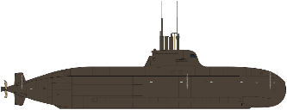
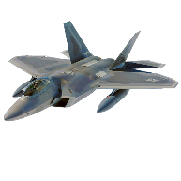
COMPLEXITY
Notes:
As shown in this infographic, considering different types of vehicles in different types of domain, a submarine is the most complex in terms of parts, the bolts, and man hours, the clocks, to be built. Submarines are also vehicles where efficiency plays a key role in energy management: conventional submarines, with a diesel engine to recharge the batteries, rely on full electric propulsion

Slide 13
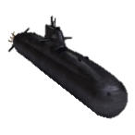
International Underwater Cooperation
1996 – 2007
1^ Batch
2008 – 2016
2^ Batch
NFS (Near Future Submarine)
Todaro
Scirè
Venuti
Romei
LAUNCH November 2003 December 2004 October 2014 July 2015
COMMISSIONING March 2006 February 2007 July 2016 April 2017
CD (Common Design), GE-NOR Cooperation
U31
U32
U33
U34
U35
U36
Notes:
The Italian Navy has more than one century of long historical tradition of conventional submarines: of the Sauro Class Submarines, 8 submarines built starting from the ‘80, the last ones are still operational at sea. But at the end of the 90’s Italy decided to make a great jump forward starting the bilateral German-Italian cooperation for the U212A submarines program, to build 10 identical conventional submarines (4 Italian and 6 German) who are still considered, for the displacement category, the best conventional submarines in the world.
The construction was started, including for the propulsion system, an ahead of the times fuel cell propulsion system: I say again, the Italian Navy started to deal with hydrogen, as an energy vector, including systems maintenance, worldwide support and refill, and operational conduct of Fuel Systems at sea, in the beginning of ‘90.
The U212A Italian Submarines have collected thousands and thousands of hours and miles at sea, we are already planning the first Mid Life Upgrade of the first 2, Todaro and Scirè, but we have to look even more further: years ago we started to drag the national industry in the development of a Near Future Submarine (NFS), that will be the future for the next decades of the Italian Submarines. The German Navy has moved from the U212A program to a cooperation with Norway to build 10 new Common Design (CD) submarines (6 German, 4 Norwegian).
Italy has taken NFS into the “OCCAR” window also to attract other nations to the program.

Slide 14
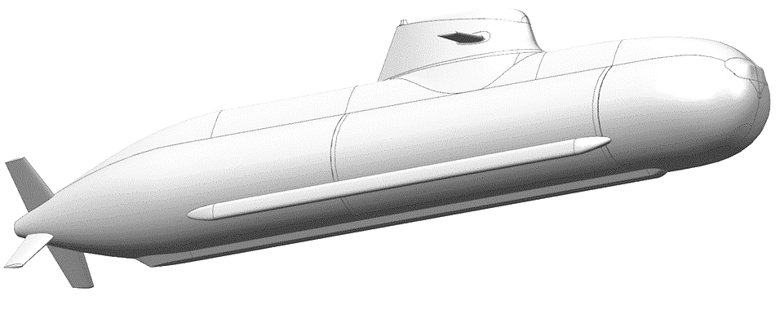
U212 NFS
(June 2031)
May 2030
(NFS 4)
February 2029
(NFS 3)
December 2027
NFS 2
February 2021
NFS 1
Contract Signed
Notes:
The contract between Fincantieri, as national design authority in submarine design, as contractor, and OCCAR, as contracting authority, has been signed on February 2021: the first steel cut of NFS I happened on January the 11th 2022, to deliver the first NFS to the Navy on December 2027.
The rise of a national capability in the development of a lithium-ion battery for submarines propulsion is one of the most recent improvements to integrate on board of future NFS, that will represent the natural evolution of the actual U212A submarines.
The decision to develop a lithium battery comes from the search for a greater endurance and more installed power, to meet the national submarines growing operational needs in terms of stealthness, during the increasingly surveillance missions of the underwater domain. This lithium technology can be integrated with the Air Independent Propulsion (AIP) system, based on fuel cells and already on board of U212A submarines, allowing reaching a further performance evolution.
Furthermore, the development of a totally national industrial capacity of building an hybrid propulsion system combining a lithium battery and fuel cells, in a market that will become extremely challenging, will drive the national companies to gain a competitive advantage over its competitors in the underwater domain, with impact and synergy also in the aerospace and automotive domains.
Finally, the combination of these electric generation systems represents the most innovative and cutting-edge technology in environmental compatibility towards zero-emission marine mobility.

Slide 15
Agenda
Introducing the U212A project: fuel cell powered submarines

Slide 16
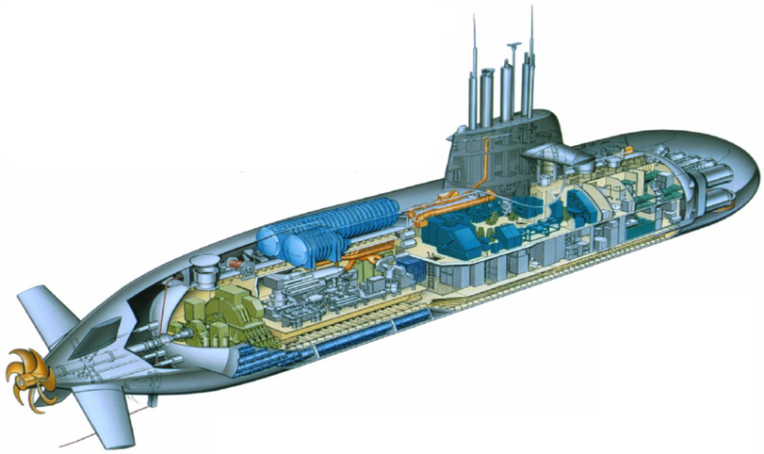
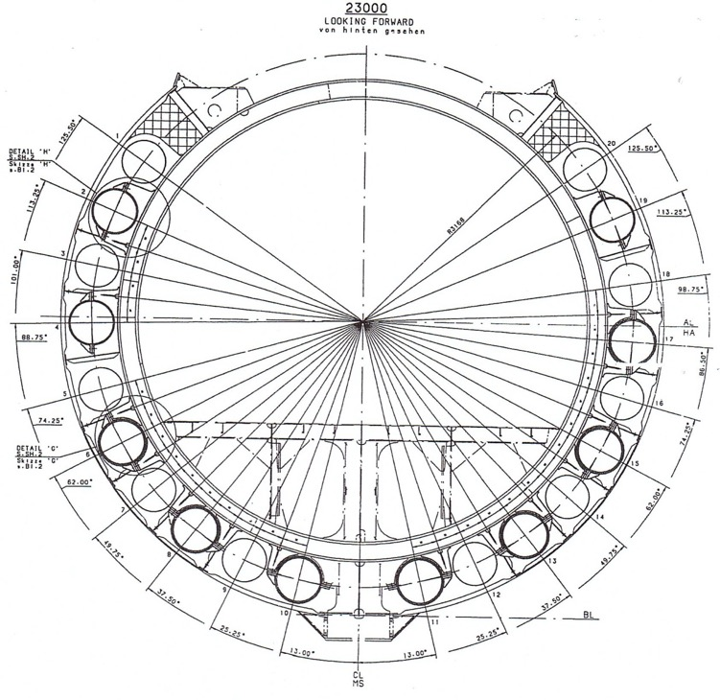
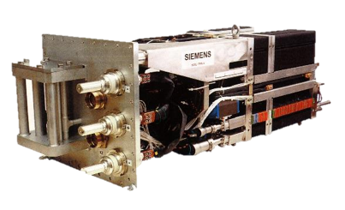
Fuel Cells
FIGURA CHE EVIDENZI il ciclo energetico FC, Storage e Idruri (anche spaccato del battello)
FIGURA Idruri (quella che avevi già messo dall’estero e la sezione)
Notes:
The requirements to be fulfilled by the AIP system of U212A, were the capacity to conduct operations without surface contact over longer periods, low noise level, low magnetic signatures, and low heat transfer to the sea water: the result of the German research, core of the U212A program, pointed out that a fuel cell power system could offer the most effective solution for application on submarines thanks to:
high efficiency of up to 70% (pure H₂/O₂ as reactants);
absolute silence of the energy generation process, normally only achievable with battery operation;
depth independence of the process;
very good operational and control features;
balance of weight by easily storing the reaction “waste” water.
On a U212A, the oxygen is stored in liquid form in cryogenic tanks and the hydrogen is stored in metal hydride cylinders where the reactant is absorbed in a “multi-component intermetallic compound hydride alloy AB2 lattice” : the metal hydride cylinders Hydrogen storage type, fulfills the specific requirements of this niche application for submarines; compared to compressed hydrogen, the metal hydride storage offers much higher volumetric storage densities, with the highest safety combined with excellent operational features.
Waste heat from the fuel cells is also used to warm the hydrides up to easy the release of hydrogen. This increases the whole efficiency of the system. The high weight of metal hydride compared to other storage technologies resulted not to be a problem for the submarine application: the storage cylinders are installed outside the pressure hull, and therefore must face very harsh requirements like diving pressure, saltwater environment, and maximum shock loads.
This AIP system has been originally combined with a classic and well-known lead acid propulsion battery, typical of conventional submarines, needing periodical recharge. The recharge of a lead propulsion battery requires diesel engines to start only when the submarine, operational at sea, returns to periscope depth: every time it happens, the stealthness of a submarine is at risk. Furthermore, lead batteries are a growth free technology, and consequently a limited maximum energy storage capacity, historically representing the main source of energy for depth diving submarines due to low cost, simple construction and management, although afflicted by a reduced average life (number of cycles), aging, sulfating, and hydrogen production risks.
In the design of the U212A submarines, the choice of the type of hydrogen storage system greatly conditioned the entire project.

Slide 17
Agenda
The lithium battery development

Slide 18
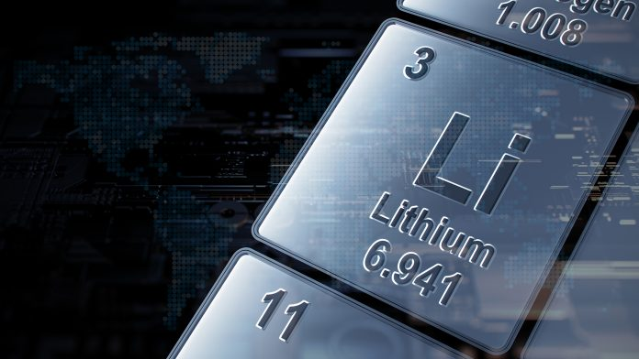
The LiB project
FIGURA generale di LITIO
Notes:
The search for better performance in terms of efficiency and energy storage capacity, has led the World Navies with submarines, to develop alternatives to the classic lead-acid batteries.
The decision of the Italian Navy Submarine Flotilla to engineer the development of a LiB propulsion system aims to provide its submarines with greater autonomy and more installed energy.
Integrating this innovative technology into the new Near Future Submarine project, according to a design “space constraint” driven, involves the rethink of various critical aspects: starting from the choice of the manufacturing chemistry throughout the on board integration process, the risk assessment, the management of the entire life cycle, the spaces and weights distribution, the auxiliaries systems, involving also operational procedures for missions and the logistic supportability of the submarine in the home base and abroad, including details as maintenance at sea of LiB cells in reduced spaces.
In addition, this type of technology perfectly integrates with the NFS Air Independent Propulsion (AIP) system based on fuel cells: due to twenty years of operation use of the AIP Submarines, the ITN Submarine Flotilla has developed extremely specialized know how and mature skills on the production, storage, transportation, and consumption of hydrogen as modern energy carrier.

Slide 19
The LiB project
Notes:
For the Italian Navy, the search for a performance better than “lead propulsion battery” in terms of efficiency, endurance and energy storage capacity, started officially in 2015 through different subsequent national military research programs, aimed to define the most suitable technology, choosing lithium, its safest chemistry, and the test protocol to be carried out on the sample cells: lithium iron phosphate (LFP) has been identified as the most suitable chemistry to ensure the best intrinsic safety.
The results of the research programs have been integrated in the Lithium Propulsion Battery Development Program, as part of the NFS building contract, signed in 2021, evolving, as first steps, into the identification of the requirements and configuration of the strings to gain a higher energy storage capacity installed on board. In the next phase, currently underway, the design of the lithium battery architecture and its monitoring and control system has started as well as the definition of the parameters to be monitored to ensure the safe operation of the system.
A lithium battery provides:
Higher energy density (up to four times);
Possibility of fast charging at high current;
Very low self-discharge;
High efficiency (95%);
Absence of memory effect;
High number of cycles (more than 2500 cycles) and service life (10 years);
Reduced maintenance required;
Reduced operating costs at higher initial acquisition investment;
High energy density (higher autonomy for the same volume);
Reduced submersible indiscretion coefficient;
Constant voltage over a wide discharge range (up to 80%);

Slide 20
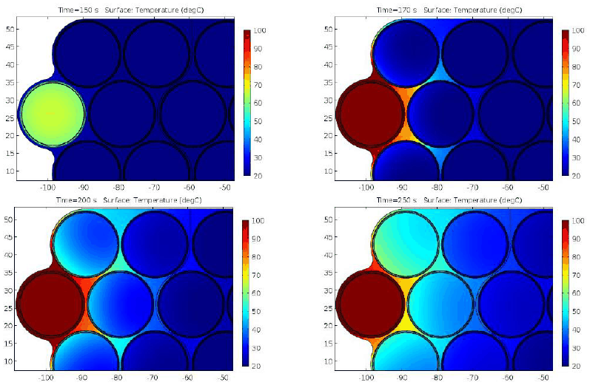
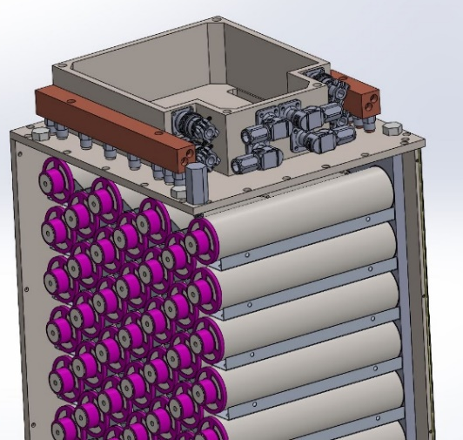
The LiB project
FIGURA di SIL, THERMAL RUNAWAY, DESIGN CELLA che si può far vedere
Notes:
For the development of the battery for NFS a structured process of risk assessment started from the initial phases of the project to identify the risk mitigation measures and the definition of the Safety Integrity Level (SIL). The SIL is the reliability index that encapsulates these requirements, i.e., the measure of the minimum reliability required for a particular safety system.
The development of a lithium battery for a submarine must be safety driven, due, as a spaceship in the space with a crew, to the peculiarity of a submarines being a confined space, operating in the underwater domain, diving through the depths of the sea.
Temperature increases, deep discharges, overloads, internal or external short circuits or damage of the container by perforation, can trigger the thermal runaway, typical of lithium batteries that can lead to fire or explosion of the cell involved with possible extension to adjacent cells.
To ensure the safety of the entire battery, it has been essential to design the cooling system that, in case of thermal runaway, quickly removes the heat produced by the reaction going to decrease the probability of explosion or fire of the cell affected by the event, thus inhibiting the possible propagation to adjacent cells. In terms of chemistry, some measures have been taken in the development phase to improve safety; the adoption of additives in the electrolyte allows raising the on-set temperature ensuring a greater margin of intervention of the control logic, while other substances inhibit free radicals ensuring a lower flammability. The specific formulation of the redox shuttle additive allows protecting the cell from overload by inhibiting the oxidation-reduction reaction at the electrodes.
A further element of study has been the development of a particular formulation of the material to be used as shut-down separator, i.e., a polymeric separator whose "porosity" (which allows the selective permeability for the passage of lithium ions in normal operating conditions) closes, due to the thermal expansion as the temperature increases, preventing the internal short circuit.
For NFS, a particular surface treatment of the collector (Positive Thermal Coefficient polymers, PTC), has also been developed to rapidly increase the resistance of the cell when crossed by high current, as in case of short circuit; the increase of resistance induces a drop in current limiting the heating of the cell (shutdown); the device, which works as a fuse, returns to its initial state when the temperature decreases again.
To reduce the probability of propagation of the thermal runaway to adjacent cells, it is also necessary to ensure a good thermal insulation of each cell using insulating layers capable of confining the overheating: for NFS an insulating layer to wrap the cells to thermally isolate the adjacent ones has been developed.

Slide 21
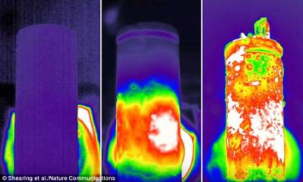
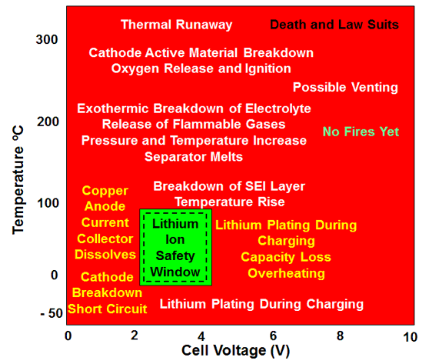
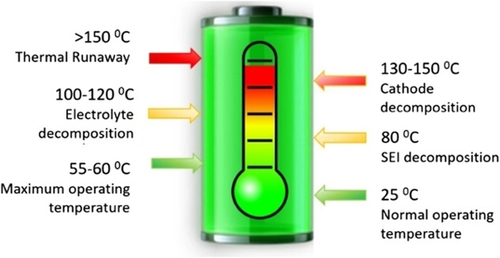
The LiB project
FIGURA di SIL, THERMAL RUNAWAY, DESIGN CELLA che si può far vedere
Notes:
For the development of the battery for NFS a structured process of risk assessment started from the initial phases of the project to identify the risk mitigation measures and the definition of the Safety Integrity Level (SIL). The SIL is the reliability index that encapsulates these requirements, i.e., the measure of the minimum reliability required for a particular safety system.
The development of a lithium battery for a submarine must be safety driven, due, as a spaceship in the space with a crew, to the peculiarity of a submarines being a confined space, operating in the underwater domain, diving through the depths of the sea.
Temperature increases, deep discharges, overloads, internal or external short circuits or damage of the container by perforation, can trigger the thermal runaway, typical of lithium batteries that can lead to fire or explosion of the cell involved with possible extension to adjacent cells.
To ensure the safety of the entire battery, it has been essential to design the cooling system that, in case of thermal runaway, quickly removes the heat produced by the reaction going to decrease the probability of explosion or fire of the cell affected by the event, thus inhibiting the possible propagation to adjacent cells. In terms of chemistry, some measures have been taken in the development phase to improve safety; the adoption of additives in the electrolyte allows raising the on-set temperature ensuring a greater margin of intervention of the control logic, while other substances inhibit free radicals ensuring a lower flammability. The specific formulation of the redox shuttle additive allows protecting the cell from overload by inhibiting the oxidation-reduction reaction at the electrodes.
A further element of study has been the development of a particular formulation of the material to be used as shut-down separator, i.e., a polymeric separator whose "porosity" (which allows the selective permeability for the passage of lithium ions in normal operating conditions) closes, due to the thermal expansion as the temperature increases, preventing the internal short circuit.
For NFS, a particular surface treatment of the collector (Positive Thermal Coefficient polymers, PTC), has also been developed to rapidly increase the resistance of the cell when crossed by high current, as in case of short circuit; the increase of resistance induces a drop in current limiting the heating of the cell (shutdown); the device, which works as a fuse, returns to its initial state when the temperature decreases again.
To reduce the probability of propagation of the thermal runaway to adjacent cells, it is also necessary to ensure a good thermal insulation of each cell using insulating layers capable of confining the overheating: for NFS an insulating layer to wrap the cells to thermally isolate the adjacent ones has been developed.

Slide 22
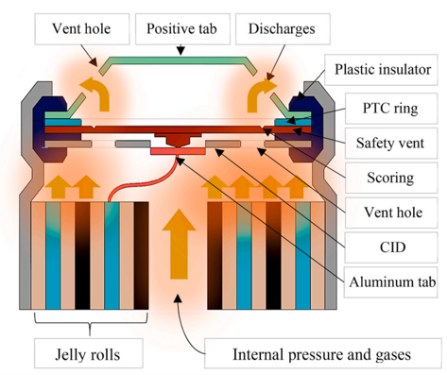
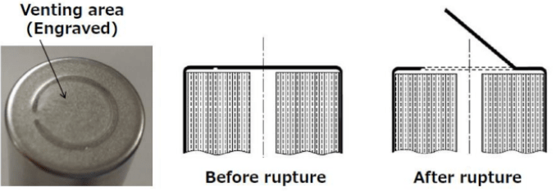
The LiB project
Notes:
Further studies have focused on the determination of the chemical composition of the gases produced during the venting phase, when different volatile organic and inorganic compounds, some of which are highly flammable, are released. From experimental tests conducted in the laboratory on different types of battery, it has been possible to verify how the chosen chemistry generates, in case of thermal runaway, a lower amount of gas than other chemicals, with the same electrical capacity; it has been also possible to determine the percentage distribution of compounds released.

Slide 23
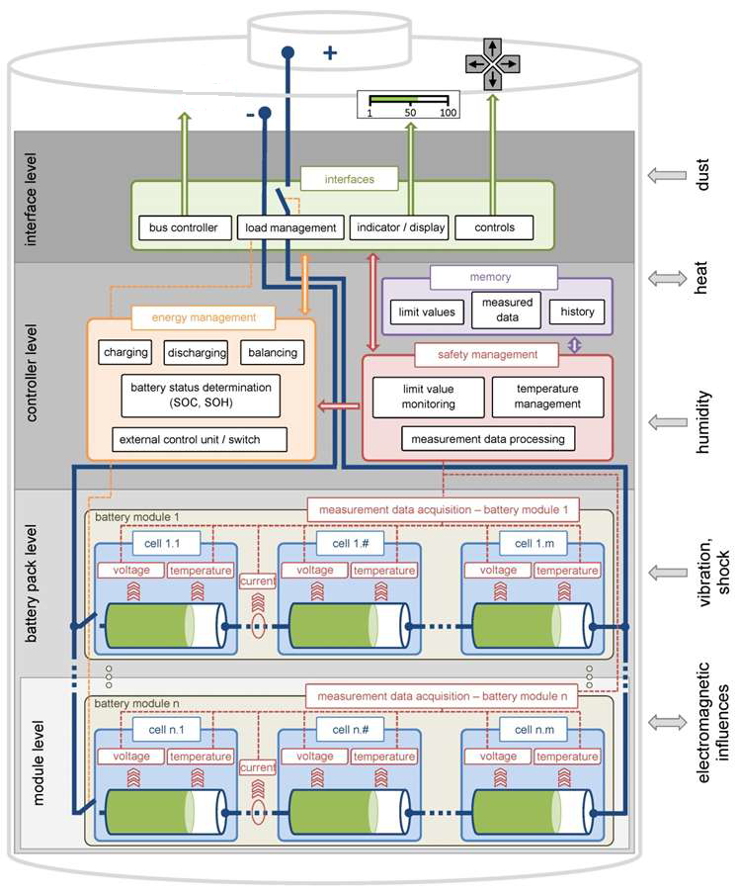
The LiB project
FIGURA su BMS e su extinguish se disponibile
Notes:
At a higher level, besides the intrinsic design of active and passive systems is able to exclude the cells in case of short circuit or uncontrolled increase of temperature, it has been necessary to develop a Battery Monitoring System (BMS): a system able to verify continuously that the operating parameters are always below the threshold values. The BMS provides a deep monitoring at the level of modules, strings, and battery, since the data to be verified are related to each cell that composes the entire battery.
Finally, even if the LBS is safety driven from the core of the chemistry, an extinguish system has been develop to instantly lower the temperature, in case of a thermal runaway.

Slide 24
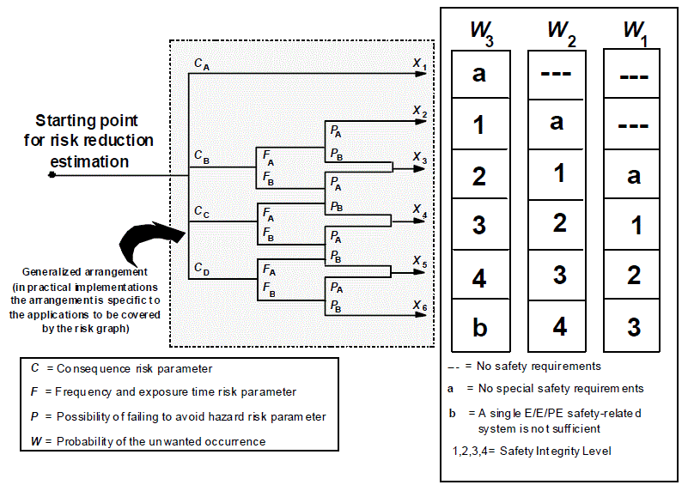
The LiB project
FIGURA su quanto scritto
Notes:
Due to the extremely innovative nature of the project, particular importance is given to the monitoring system; thus, it is closely related to functional safety, i.e., the process of identifying and assessing risks and dangers and their mitigation through risk identification (HAZID), risk assessment and finally the definition of the objective Safety Integrity Level (SIL).
The minimum requirements of SIL, as provided by the standard IEC/EN 61508 [7], identifies the integrity levels for safety functions "standard" necessary to design the BMS that is essential to ensure the safe operation of the cells in the area of operation.
Specifically, the risk analysis process conducted for the LIB development process intended for use on board the U212 NFS submarines, has been articulated in a series of activities that will see the issuance of certification of the entire engineering process by qualified certification authorities.
The qualification and certification processes is structured into the following phases:
Definition of the normative references for the Qualification of a technologically innovative product, due to the field of use, submarines;
Identification of the risk analysis procedure;
Identification and quantification of risks;
Definition of the acceptable level of risk;
Identification of the measures of mitigation and control of the risk;
Identification of the SIL level achieved based on the active safety systems implemented;
New risk assessment procedure after implementation of safety systems;
Certification release and qualification of the project development process.
In the early stages of development, the following causes have been considered to lead to a cell failure:
Inadequacy of cell chemistry for the application;
Poor product or production quality;
Incorrect assembly of the components inside the cell;
Damage due to lack of maintenance or improper use;
Mechanical damage (abuse);
Incorrect management of charges/discharges.
During the first tests, it has been observed that it is mandatory to ensure the adequacy and quality of the entire production chain to prevent defects in the separator, hot spot due to inhomogeneity of the active matrix, and metallic residues of processing and internal defects in conductive materials that lead to cell failure.
Finally, the chosen path for the development of national lithium battery propulsion system for submarines, always safety driven, can be extremely summarized in:
Research of the most suitable chemistry for the type of application;
Improvement of construction techniques;
Improvement of the quality of the supply chain, from raw material suppliers to the manufacturer;
Implementation of passive protection measures;
Implementation of an appropriate electronic management tools (BMS).

Slide 25
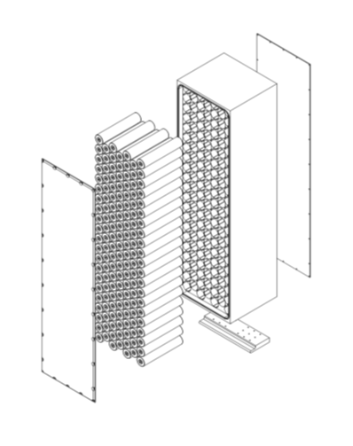
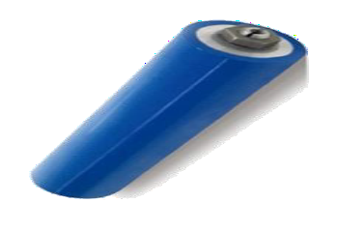
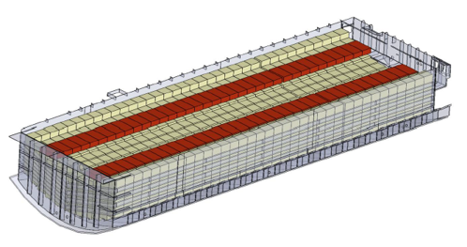
The LiB project
FIGURA, qualche figura recente su Litio e NFS che ovviamente possiamo «rilasciare»
Notes:
The development program is now ongoing under the umbrella of the “NFS Programme”, evolving from years of study, and actually facing the challenges of the final design of the battery, that in a submarine is a project space and weight driven, as in a spaceship. Integration on board according to the current architecture is also a strong constraint, making the battery installable on board of U212A submarine, without structural changes. The definition of the size and number of the LBS cells is now one of the development main challenges, aiming at the maximum energy capacity achievable through Lithium, for the propulsion battery, versus the space and weight constraints, identifying the optimal tradeoff.
Furthermore, lithium is a technology with a growth model that will allow through time to increase energy capacity using the same volumes inside the submarine.
The development program, although extremely challenging, is representing a fundamental moment of growth for both the Navy and the National Industry, facing and solving problems of high complexity.

Slide 26
Agenda
The smart e-submarine: fuel cell and lithium battery integration in Next Future Submarine

Slide 27
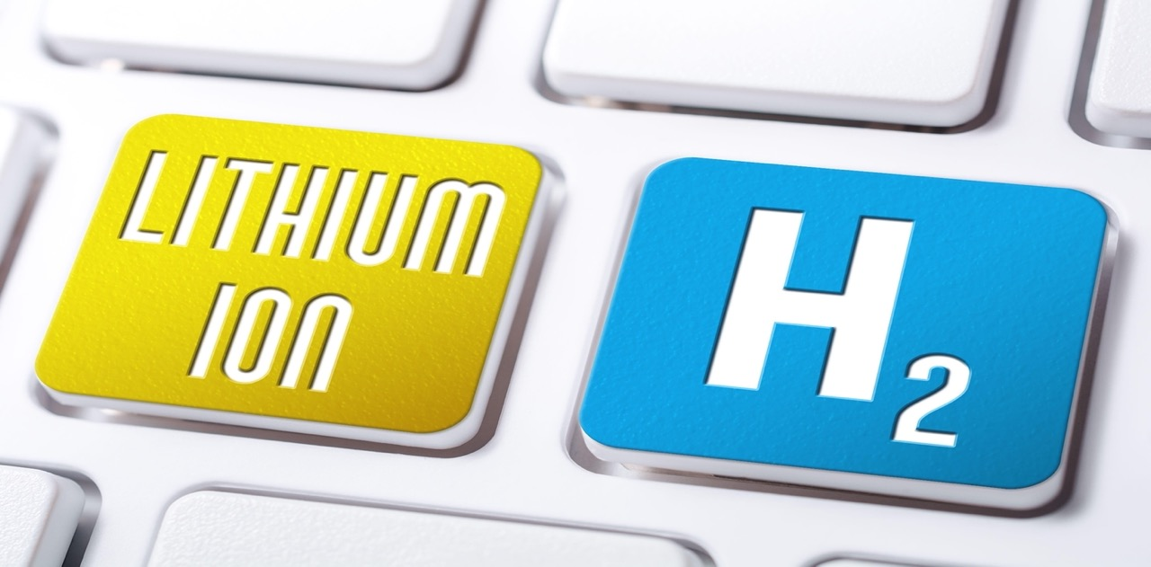
Towards a smart e-submarine
Notes:
To improve the performances, the NFS project follows this direction using different sources and combinations of combustion (ICE), electrochemical (batteries and fuel cells), stored (hydrogen) and hybrid power supply. This hybrid architectures and advanced control strategies lead a reduction of the fuel consumption and the emissions.
A further advantage of fuel cells and lithium batteries is that they generate little noise or vibrations. The silent electric motors for propulsion have a high efficiency (i.e., 95%) and when combined with efficient fuel cells (i.e., 45-65%) show a significant improvement over internal combustion engines that require 44% more fuel than a fuel cell of the same output power.
The combination of fuel cell and lithium battery will allow increasing the submarine operational range through a more efficient management of stored energy. As in a small smart grid, the two power sources will interact at the point of maximum efficiency. The fuel cells will ensure continuous AIP operations, enabling the submarine to dive stealth for an extended period without having to return to periscope depth, whereas the lithium battery will allow maintaining high discharge rates for longer duration.
The benefits of applying stored and hybrid power supply in power and propulsion plants are also in the storage, which can enable switching off the engine when it would be running inefficiently at a partial load; the battery is charged by the engine running at its operating point with lower emissions and maximum efficiency [8]. The battery can enable load leveling, by handling the power fluctuation. This results in constant loading of the engines, maintaining a more efficient operating point.
The integration of Fuel Cells and Lithium Battery for the propulsion system of the NFS submarines represents a smart grid on an e-submarine, as an optimum combination of energy saving technologies chosen during the design phases and an inspiration in the field of energy efficiency and environmental sustainability.
The growing electrical capacity stored on board, will also drive the submarine to a complete electrification of the systems, already on going on the NFS Project, for example with the adoption of Electric Masts a previously hydraulic domain.

Slide 28
Agenda
How hydrogen and lithium batteries can boost the development of a green marine mobility

Slide 29
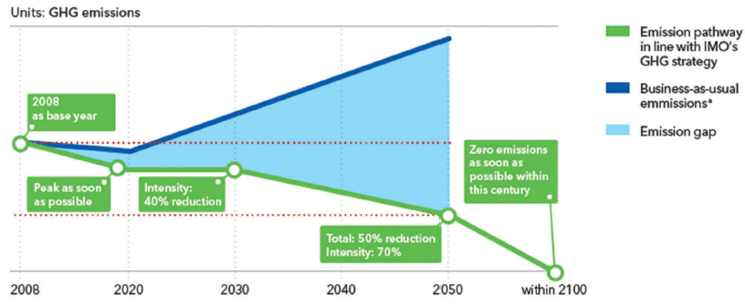
Green marine mobility
source: DNV-GL 2019
Notes:
To contrast the continuing inexorable increase in pollutants, in 2018 IMO agreed to introduce a regulation framework to reduce GHG emissions by 50% by 2050 compared to 2008 through more efficient ships, operational and logistical improvements, and the use of alternative fuels.
There are many areas for action to reduce emissions, among which energy efficiency, i.e., a mix of energy sources that allow each to work at maximum efficiency in order to lower consumption and, therefore, the emission of particulates and other pathogens, is of particular importance.
The research in efficiency drives the new trend in the design of more versatile ships using hybrid propulsion and alternative power supply architectures. To improve performance, intelligent control strategies are required using different sources and combinations of combustion (ICE), electrochemical (batteries and fuel cells), stored (hydrogen) and hybrid power supply. The hybrid architectures and advanced control strategies of a smart ship can reduce fuel consumption and emissions up to 10–35%.

Slide 30
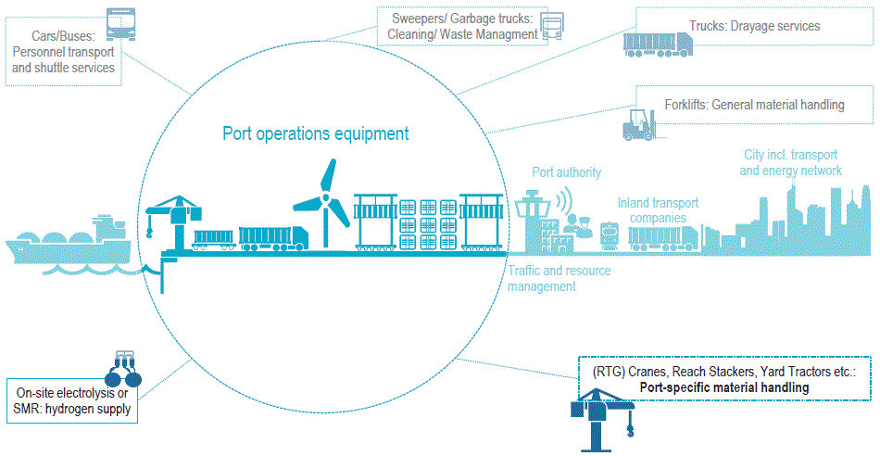
Green marine mobility
Notes:
In the long term, there are good outlooks for hydrogen applications in transportation segments due to its wide range of generation sources and low emission characteristics; this makes hydrogen an ideal alternative to fossil fuels to achieve IMO's zero emission target. However, the development of a sustainable hydrogen economy for global shipping depends on the technical feasibility and cost-effectiveness of large-scale production, storage, transport, and distribution, considering the significant investment required for dedicated infrastructures. Barriers for energy end-users can be defeated through the development of more technologies for hydrogen power use. Hydrogen also faces the usual challenges of new technologies: lack of economies of scale, lack of variety in vehicle options, public misperceptions and lack of awareness, perceived risk dislike, and the need to establish an adequate institutional infrastructure. In this context, the creation of renewable fuels hubs should be the right choice to solve the problem and to make these fuels competitive.
The Italian Navy, thanks to the experience acquired in about 20 years of operational use and worldwide support to submarines equipped with a fuel cell propulsion system, has developed expertise in all fields, from production, storage, transport, use, of the potential green supply chain of hydrogen.
The ultimate goal is to make this specialized expertise available to the Nation, as a driving force for industrial and academic research and development, in a field that is winning and preponderant for the future, driving the development of a green marine mobility.
Furthermore, lithium batteries and hydrogen as energy vectors, represent a winning mix also regarding the space domain challenges; already widely used in the past in space missions, these technologies could in the near future give greater boost to space explorations thanks to the renewed interest in this powerful kind of energy storage.

Slide 31
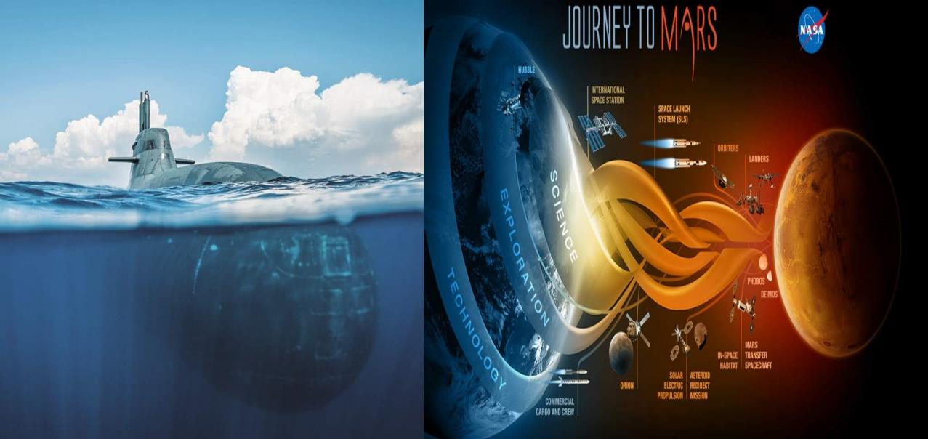
CONCLUSIONS
Notes:
Ships emissions currently have no economically viable options for a complete de-carbonization, but submarines propulsion systems represent a first step towards a fully integrated green power train.
Lithium technology represents a real turning point for underwater propulsion; thanks to its versatility and performances in terms of density of energy, Lithium will allow the next NFS Submarines of the Italian Navy to increase performance in terms of stealthness, increasing deep diving operational time. In combination with the already proven AIP fuel cell system, it will be possible to achieve performances comparable only to those of non-conventional vessels, with the added advantages of silent running, maneuverability of a compact design (vs nuclear submarines) and environmental sustainability.
The NFS, already an e-submarine with an internal propulsion smart grid, will be a fundamental node of a ground based smart grid, for hydrogen production and storage, and lithium batteries charging and monitoring systems. The technological growth driven by the development of these systems and the rising electrification of submarines, will drive the national industry to increase its specialized know-how assuming a leading position in the sector at a worldwide scale, representing a very competitive test bed for the achievement of the objectives of environmental sustainability and reduction of greenhouse gas emissions for shipping. Finally, NFS, from the underwater domain, like a spaceship in the space domain, guarantees R&D, national knowledge and building capabilities, in branches, like Hydrogen and Lithium Propulsion Batteries that are actually at the top worldwide attention in domains like Space and Automotive.

